Slide 1


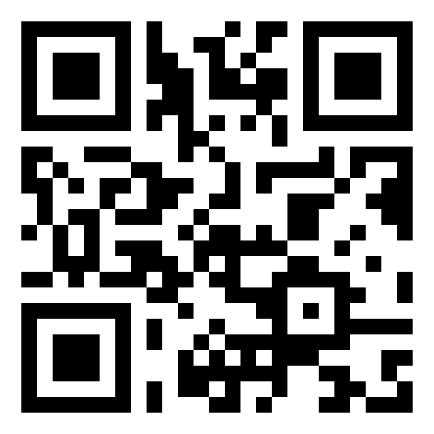
Keep Technically
Current
Continue to advance your career and keep abreast of new and changing technologies. IEEE has the means for you to remain technically current through award winning publications, and technical societies.
Learn more
www.ieee-bv.org/learn

Slide 2

Career Resources and Recognition
Leadership is a skill that must be crafted over time. Keep your career moving in the right direction with IEEE career benefits and resources.
Learn more
www.ieee-bv.org/learn

Slide 3

Professional Networking
With other IEEE members who share similar interests, you can build a network revolving around your profession, industry or projects.
Learn more
www.ieee-bv.org/learn

Slide 4

Continuing Education
Keep growing with IEEE continuing education benefits and other educational opportunities available to IEEE members. These resources allow you to acquire new skills and advance your professional development.
Learn more
www.ieee-bv.org/learn

Slide 5

Discounts
IEEE members enjoy reduced rates on many proprietary products and services including IEEE books and eBooks, journals and articles, conferences and proceedings, standards, society memberships, and continuing education courses. In addition, members have access to a variety of affinity programs that offer savings.
Learn more
www.ieee-bv.org/learn

Slide 6

Humanitarian Programs
Volunteering is a rewarding way to develop interpersonal skills, create new professional relationships, and apply your expertise to help others.
Learn more
www.ieee-bv.org/learn

