Slide 1
Officer Orientation Buenaventura Section
Steven F. Johnson
Senior Member, IEEE
May 20, 2015

Slide 2
IEEE Mission and Vision
IEEE's core purpose is to foster technological innovation and excellence for the benefit of humanity.
IEEE will be essential to the global technical community and to technical professionals everywhere, and be universally recognized for the contributions of technology and of technical professionals in improving global conditions.

Slide 3
Opening Remarks and Welcome Steve Johnson

Slide 4
Tonight’s Topics
How We Tie In to the Broader IEEE – Doug Askegard
Section Summary
The Section Web Site
Best Practices
Volunteers
Fundraising
Logistics
For Further Information

Slide 5
Region 6 Spring 2015 Update
Doug Askegard, Region 6 Southern Area Chair
Tom Coughlin, Region 6 Director
May 2015

Slide 6
Outline
IEEE Intro Slides
Region 6 Initiatives
Region IEEE Election
6 Conferences
IEEE in 2030 Initiative

Slide 7
IEEE Organization
MEMBERS
Board of Directors
Assembly
Member & Geographic Activities
Technical Activities
PSPB*
Executive Comm.
Standards Assoc.
Regions & Sections
Societies & Technical Councils
Educational Activities
Staff & Society Executive Directors
IEEE-USA
*Publication Services & Products Board

Slide 8
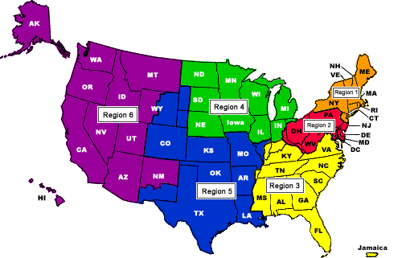
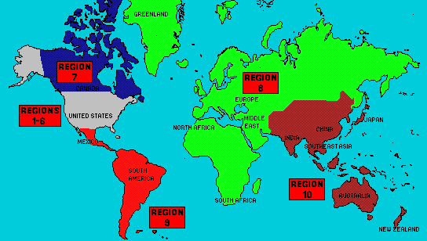
10 Regions, more than
300 Sections and
1,450 Student Branches, 38 Societies, 7 Councils, plus a growing number of Networks and Communities
425,000 members

Slide 9
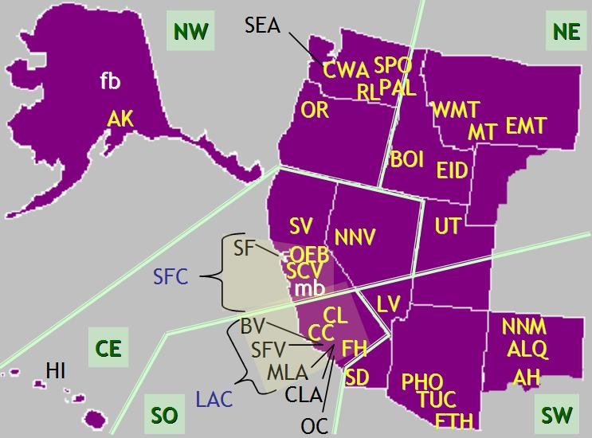
5 Areas
35 Sections, 2 subsections, 2 councils
Over 228 chapters and affinity groups
95 Student Branches
About 55,000 members
http://ieee-region6.org/

Slide 10
IEEE Region 6 Objectives, 2015
Respect and enable the volunteer
Enhance membership and improve retention
Enhance our on-line experience
Create active alliances with industry and VCs
Create active alliances with academia
Create active alliances with technically oriented cultural groups and STEM
Recognize and celebrate our history
Make IEEE Region 6 cool, be creative

Slide 11
Region 6 - Initiatives
Membership in arrears recruitment and membership recognition
Region 6 conferences
On-line conferences
Chapter meeting recording
Program management for Region 6 activities
Creating alliances with industry and academia
Student and STEM Support
Region 6 IEEE Engineering Milestone Coordinator
Notes:
30,000 for ghtc, 2500 Sustech, 15000 Rising Stars

Slide 12
Membership Initiative – Member to Member Renewal
Towards the end of February 2015 IEEE discontinued membership for folks that didn’t renew their membership
In March 2015 Region 6 began a pilot micro-volunteer program, with IEEE Membership Recruitment, to get IEEE volunteers to sign up to make calls to a list of 10 people in their Section
An incentive program was created for callers who are able to get discontinued members to renew
Over 50 people have already signed up to do these calls
You can find out about this program and sign up to volunteer at: http://ieee-region6.org/2015/microvolunteer-project-non-renewing-member-survey/

Slide 13
Membership Initiative – Elevations
Associate to Member elevation information: http://www.ieee.org/membership_services/membership/grade_elevation.html
Senior membership elevations
Organize local activities to get eligible members elevated
This recognizes our members for their experience and may help with retention
Sections can order membership loyalty recognition pins from the IEEE, www.ieee.org/loyalty

Slide 14
IEEE Elections (this Summer)
There will be the usual slate of candidates running for various IEEE offices, please read their information at: https://www.ieee.org/about/corporate/election/candidates.html
In addition there is a very important additional item on the ballot, major changes are proposed for the IEEE constitution. I urge you to read the proposed changes in detail and make an informed vote. You can find out more about the proposed amendments and participate in discussions at: http://theinstitute.ieee.org/briefings/business/proposed-amendment-to-the-ieee-constitution
You can see the actual amendments compared to the current constitution at: http://www.ieee.org/about/corporate/election/2015_constitutional_amendment.html

Slide 15
Region 6 Conferences
WIE-ILC – April 23-25, 2015, San Jose
Career & Talent Expo (On-line), June 1-30, 2015
SusTech – July 30-August 1, 2015, Ogden, Utah
GHTC – October 8-11, 2015, Seattle
Rising Stars—January 3 & 4, 2016, Las Vegas
Women in Engineering
International Leadership Conference
SUSTECH 2013

Slide 16
Career & Talent Expo (June 1-30, 2015)
Schedule
Expo – June 1-30, 2015
Career Resource Access – June 1-9
Live Recruiting Sessions – June 10-12
On Demand Event Follow Up – June 13-30
Combining 2 highly effective technologies to provide scientific job matching on a virtual platform environment
14 Industry disciplines showcased in related exhibit halls
Global and national reach – All IEEE members invited
Validated talent assessment offered to all participants
3 Corporate sponsorship packages available—looking for sponsors
Free to IEEE members, non-members pay or become members both in Region 6 and elsewhere

Slide 17
Career & Talent Expo Member Benefits
Free personal skills assessment report provides 7 advantages in career development
Take the DISC [personal skills assessment test at: http://www.ttisurvey.com///230492JME and find out what your employable strengths are
Supporting career and industry content provided at the event
Active and passive seekers, or those looking to build a network for future advancement are all welcome to tap into the world- class resources
When job matched, statistics show people have more success
Finding the right home for one’s unique abilities brings happiness, less stress and more productivity
This event will be linked to the Rising Stars in January 2016
More Information: http://ieee-region6.org/2015/career-and-talent-expo-2015

Slide 18
Virtual and Hybrid Conferences
IEEE Region 6 has acquired a license for a program available from the IEEE EAB for hosting virtual events
We used this capability for the first time for the 2015 Rising Stars Conference
We plan to make this capability widely available for Region 6 events in 2015
This functionality can be used for many different types of events…

Slide 19
Create an On-Line Collection of Technical Chapter Meeting Recordings
IEEE New Initiatives Comm. (NIC) funding of a pilot program in Region 4 and Region 6 into the Fall of this year
We will host these recordings—they will be available for free to all IEEE members
We intend to sell access to these recordings to non-members--enhance IEEE membership
We could have 100’s of these in a year’s time, 1000’s in 5 year’s time—this is cutting edge material
We are offering discounts for microphone packages and offering Camtasia licenses. We are doing training to Section and chapter leaders—Contact Scott Tamashiro if you are interested in these packages (Scott Tamashiro (tamashiro@ieee.org) .

Slide 20
R6 Precollege Outreach Timeline for 2015
January: Commit my Section to SOME outreach
February: Identify a PreCollege Outreach Chair
March: Region’s first mailing / mail list needed!
April: Have a plan for a visit, an event, an effort
May: Post each Section’s plan to Region website
June: Execute the visit, event, effort. Take pictures!
July: Provide at least one picture to Region
September: Post pictures to Region Website
October: Encourage further events
December: Recognize the Pt, Au, and Ag Sections!

Slide 21
Many of our Sections have reported their Precollege Outreach Chairs!
Section Name | PACE/Pre-College Contact
Albuquerque Section | Gilberto Zamora
Boise Section | Kristen Hopper
Buenaventura Section | Robert Rumer
Central Washington Section | Randall Groves
China Lake-Bakersfield Section | Octavio Escobedo
Coastal Los Angeles Section | Shantaram Vasikarla
Eastern Idaho Section | Hope Forsmann & Jake Gentle
Foothill Section | Raymond Roberts
Fort Huachuca Section | Keith Moore and Ann Hartfiel
Oakland-East Bay Section | Bill DeHope
Orange County Section | Adriana Cardenas
Richland Section | Jereme Haack
San Diego Section | Kesh Bakhru and Mike Davis
Seattle Section | Alon Newton
Utah Section | Dan Christensen
Email your contact to: rameshnair@ieee.org

Slide 22
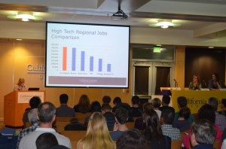
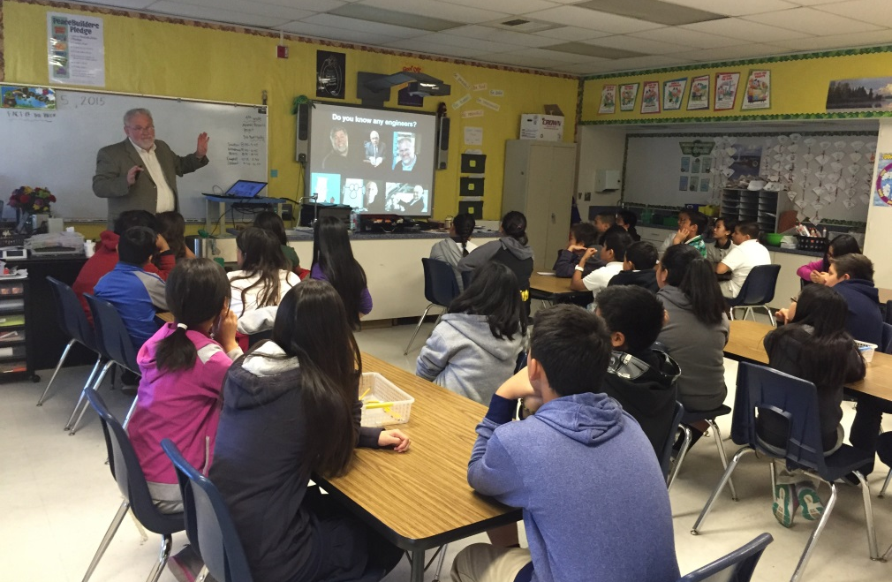
Examples of Section events
Buenaventura Section: STEM Career Night
Oakland/East Bay Section: Spangler Elementary Engineer Visit
Send your event to: rameshnair@ieee.org
Ideas for outreach at http://ieee-region6.org/k-12-programs/

Slide 23
Other Initiatives
We are trying to use project management tools as well as micro-volunteering to make it easier for professional volunteers to help Region 6. Karen Day from the NW area is helping us with this.
Region 6 has money available for local Sections to host breakfasts or lunches with local industry leaders. In the Santa Clara Valley Section they do this about once a quarter with about 30 companies participating
Region 6 leaders are seeking IEEE Engineering Milestones in Region 6 and there is a Region 6 Milestone coordinator who can help you with this process—Brian Berg, brianberg@gmail.com

Slide 24
Your IEEE Resources
ieee.org
ieee-usa.org
ieee-region6.org
students.ieee-region6.org

Slide 25
Thank you !

Slide 26
IEEE in 2030 Initiative
Participants
Board of Directors
Management Council
Selected guests (age, geography and technical diversity)
Supported by the 2015 and 2016 IEEE Presidents to focus on how best to evolve IEEE to meet the diverse challenges of the world in 2030
Driving question: What changes must we make now to best position IEEE for success in 2030, while still supporting the needs of technologists between now and then?

Slide 27
Goals for 2015 (for 2030)
Roadmaps will be developed for each of the four Strategic Objectives proposed to the IEEE Board of Directors for adoption
Roadmaps will include milestones, owners, budget, etc.
Significant progress will be driven by IEEE Ad Hoc Committee on 2030 on Strategic Objectives 1 and 2
[1] Create a Nimble, Flexible, Forward-looking Organization
[2] Foster Public Imperatives
Substantial work will be adopted by logical “home” Organizational Units, teams, affinity groups, etc. in Strategic Objectives 3 and 4
[3] Foster Diverse Technical Communities with Industry, Government, and Academia
[4] Empower the Discovery, Development and Delivery of Cutting-edge Products and Services
Please send feedback to: feedback2030@ieee.org

Slide 28
Region 6 Student-Targeted Efforts
Improve student branches by improving Section relations with their student branches.
Communication and supporting involvement in wider IEEE activities.
Improve effectiveness of area meetings for student members
Student competitions need to be made relevant and appealing.
Career & Talent Expo – June 2015
Rising Stars – January 3 and 4, 2016

Slide 29
Region 6 is committed to STEM outreach
Funding for STEM outreach
It’s our future
It can be 3% or 33%...but not 0!
Even if it’s not YOUR cup of tea--Delegate! Frequently but not exclusively, a PACE function
Sections provide and communicate options to members, encourage involvement, publicize successes
Appoint a Pre-college Outreach Chair
Hold at least ONE precollege STEM event in 2015
Tell your Region about it!
See our website: http://ieee-region6.org/k-12-programs/

Slide 30
Tonight’s Topics
How We Tie In to the Broader IEEE
Section Summary – Nathalie Gosset
The Section Web Site
Best Practices
Volunteers
Fundraising
Logistics
For Further Information

Slide 31
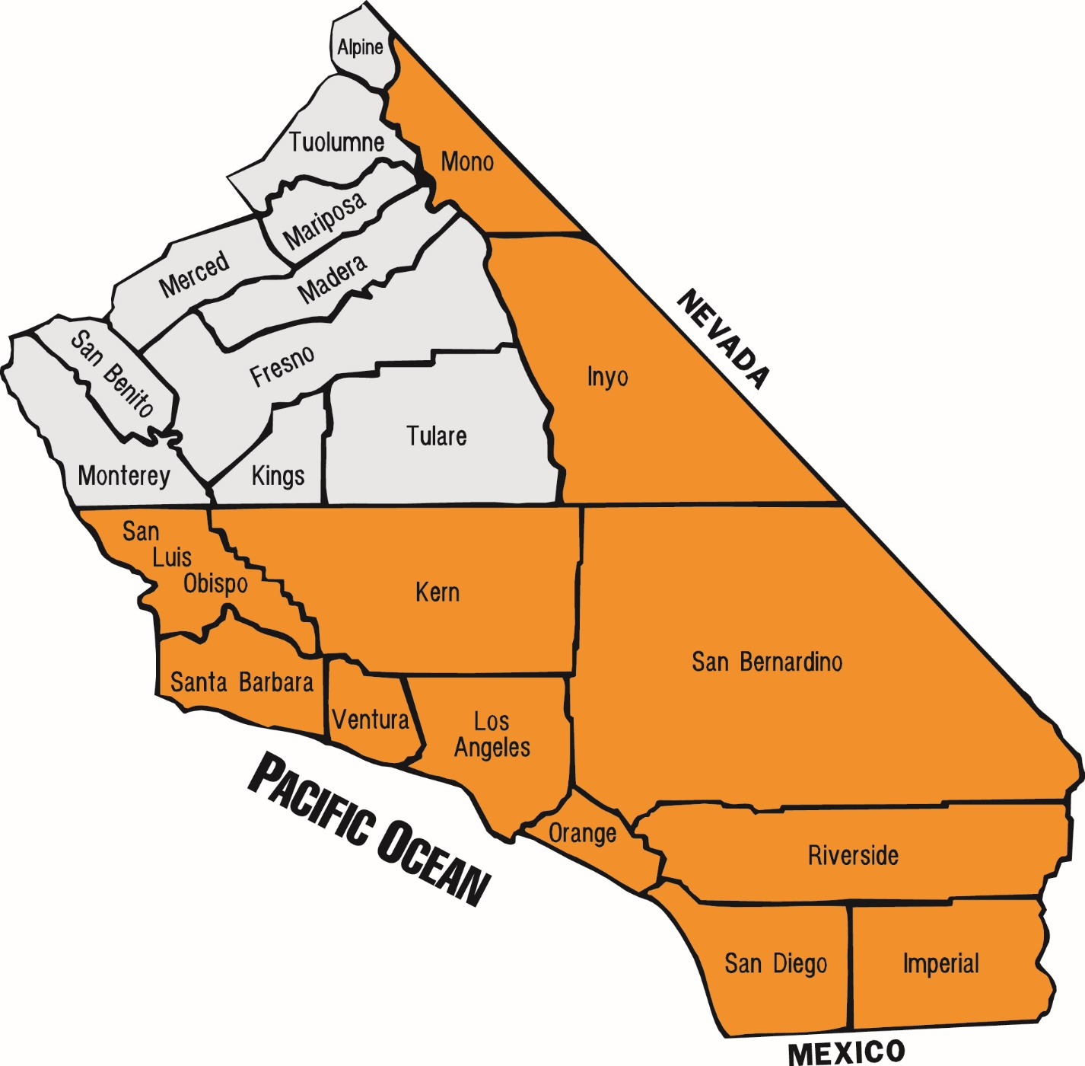
IEEE Buenaventura Section
716 Members
10 Chapters
55 Officers / Volunteers
NEED 15 MORE
2015
Membership Renewal: 85%
Membership Increase: 12%
Our Section

Slide 32
2015 Buenaventura Section Activities
Plan
Completed
Technical Talks
58
OpCom
Student / Career
Events
Entrepreneurship
Workshops
12
7
6
Officer
Training
Evenings
Awards/
Fundraiser
Events
Mixers
Senior
Member
Elevation
21
2
2
2
3
4
1
1
1
1
1

Slide 33
Why our Section Stands Out
Number of Members
15
28
28
2
11
2
34
In 2014 the BV Section was the 2nd smallest Section (769 members)
but the most active Section by far in the Greater LA with 34 technical meetings
(number of the columns represents the number of technical events)

Slide 34
AESS
COMSOC
CS
ED/CAS
0
2
4
6
8
10
12
14
0
2
4
6
8
10
12
14
0
2
4
6
8
10
12
14
0
2
4
6
8
10
12
14
Officers/Volunteers
Officers/Volunteers
Officers/Volunteers
Officers/Volunteers
0
2
4
8
10
12
14
0
2
4
8
10
12
14
0
2
4
8
10
12
14
0
2
4
8
10
12
6
6
6
6
14
2015 Talks
2015 Talks
2015 Talks
2015 Talks
$1K
$2K
$3K
$4K
$1K
$2K
$3K
$4K
$1K
$2K
$3K
$4K
$1K
$2K
$3K
$4K
2015 Operating Funds
2015 Operating Funds
2015 Operating Funds
2015 Operating Funds
EMBS
EMC/CE – New Chapter
IPS – NEW Chapter
LMAG
0
2
4
6
8
10
12
14
0
2
4
6
8
10
12
14
0
2
4
6
8
10
12
14
0
2
4
6
8
10
12
14
Officers/Volunteers
Advisors
Officers/Volunteers
Officers/Volunteers
Officers/Volunteers
0
2
4
8
10
12
14
0
2
4
8
10
12
14
0
2
4
8
10
12
14
0
2
4
8
10
12
6
6
6
6
14
2015 Talks
2015 Talks
2015 Talks
2015 Talks
$1K
$2K
$3K
$4K
$1K
$2K
$3K
$4K
$1K
$2K
$3K
$4K
$1K
$2K
$3K
$4K
2015 Operating Funds
2015 Operating Funds
2015 Operating Funds
2015 Operating Funds
MTTS
RAS/IAS
ENTREPRENEURSHIP
WEBSITE Team
0
2
4
6
8
10
12
0
2
4
6
8
14
10
12
14
0
2
4
6
8
10
12
14
0
2
4
6
8
10
12
14
Officers/Volunteers
Officers/Volunteers
Officers/Volunteers
Officers/Volunteers & Advisors
0
2
4
8
10
12
14
0
2
4
8
10
12
14
0
2
4
8
10
12
6
6
6
14
CHAPTERS
2015 Goals and Actuals
2015 Talks
2015 Talks
2015 Talks
$1K
$2K
$3K
$4K
$1K
$2K
$3K
$4K
$1K
$2K
$3K
$4K
2015 Operating Funds
2015 Operating Funds
2015 Operating Funds
Goal
Fee for workshops

Slide 35
IEEE Buenaventura Section Metrics 2015 as of May 2015
0
2
4
6
8
10
12
s
10 20 30 40 50 60
14K
20% 40 60 80 100%
s
0
0
Membership Retention
Goal 89%
Actual 85%
Need another
members to renew
Membership Recruitment
Goal 55 new members
Actual 42 new members
Need 13 more members
Fundraising for Section
Goal $13.7K
Actual $13.1K

Slide 36
Collaborations
IEEE
Operations
Groups We Serve
Charitable Outreach
R6
LMAG
EMBS
IAS
IEEE
Pre-U
Skyworks
CAIRO
NEWC
AAUW
CLU
CSUCI
VCOE
IEEE Members
High School Students
College Students
Food Pantry
Salvation Army
Sponsors
Advanced Personnel Profiles
California Lutheran University
Ciao Wireless
Farmers Insurance
Integrity Staffing
Login Associates
MicroJoining
Syntesis Global

Slide 37
Changes 2014 → 2015
Microvolunteerism → More volunteers recruited
Website(6 people)
Building teams of 8 officers per chapter
Empowerment
2015 Plan defined in January
Budget: Upfront allocations
All groups support each other
Advisory Board– Great guidance to solve specific targeted areas
Amplification of Impact
Focus on the Member
Collaborations with other organizations
Charitable outlet added to events

Slide 38
Upcoming Large Section Event Mixer July 22nd
Around The Earth: From 60 Days To 60 Milliseconds

Slide 39
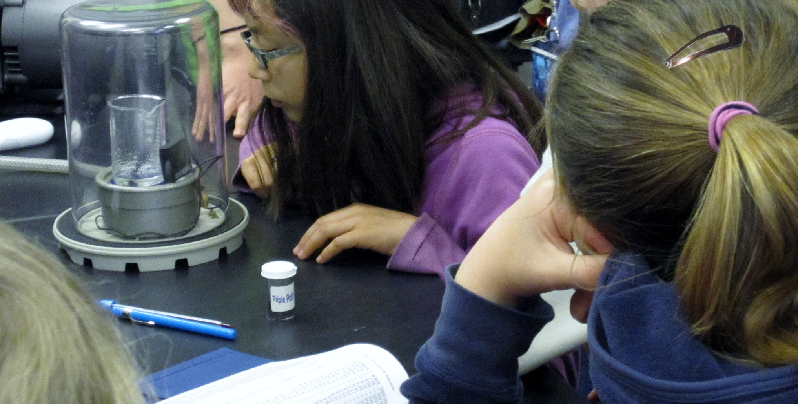
Upcoming Large Section Event Sep 19th (tentative)
Introduction to Engineering for Girls ½ Day Workshops

Slide 40
Upcoming Large Section Event Sep 24 or Oct 22 – Fall Event
The Hitchhiker’s Guide To New Technology Frontiers

Slide 41
Outreach Activities
Pre-University
University
Industry Relations
Mentor Program
Young Professionals
Professional Transition
Networking - Mixers

Slide 42
Tonight’s Topics
How We Tie In to the Broader IEEE
Section Summary
The Section Web Site – Steve Johnson, Deron Johnson
Best Practices
Volunteers
Fundraising
Logistics
For Further Information

Slide 43
Section Website: ieee-vb.org Steve Johnson, Deron Johnson, Team
The public face of the Section
Our web team:
Steve and Deron
Stephanie Knotts, Mrityunjay Kumar, Larry Brown, Rick Poore, Ken Dayton
Monthly editorial cycle follows newsletter
Ad-hoc notifications
Section, Chapter resources

Slide 44
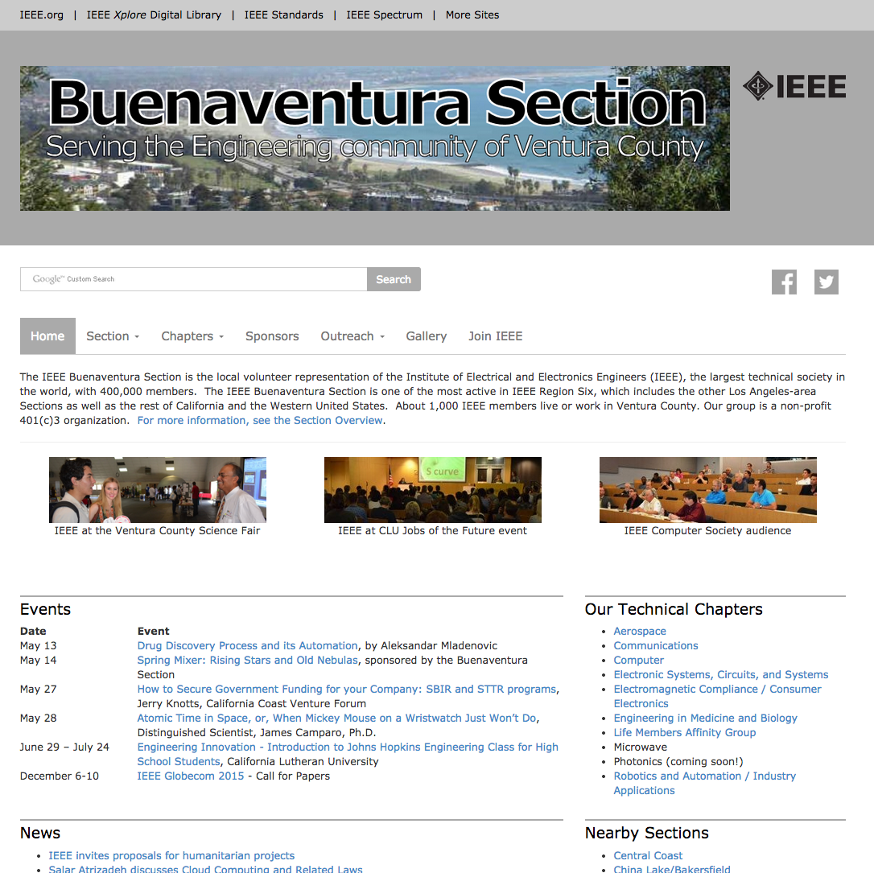

Slide 45
Tonight’s Topics
How We Tie In to the Broader IEEE
Section Summary
The Section Web
Best Practices – Steve Johnson
Volunteers
Fundraising
Logistics
For Further Information

Slide 46
Best Practices
How to build up and lead a chapter
How to find speakers
How to handle speakers
What you should expect of speakers, and what they should expect of you

Slide 47
Building and Leading a Chapter
The “checklist process” of starting a chapter is pretty straightforward, but when is the time right to do so?
The IEEE’s process is built around some useful thresholds, such as 12 technical society members in the section, identification of four key officers, etc.
While you’re meeting the minimum requirements, also take the time to write a two-page “business plan”:
What will the objectives of the chapter be?
Who is your target professional audience? Is it big enough to sustain 2-10 technical meetings a year?
Plan your first year’s speaker list – contact them for informal acceptance of your invitation.
Where will you meet? Is it a free venue?

Slide 48
How to Find Speakers
Does your organization (employer, university, etc.) already bring in speakers on a regular basis? Invite them to speak at an IEEE meeting as well.
Who are your professional contacts? Your mentors? Your manager? Your suppliers or customers? Think LinkedIn!
Ask a colleague if she would like to talk about her work at an IEEE technical meeting.
Contact the Section Chair for SAMIEEE information about Senior / Life / Fellow members in your technical society nearby.
What intrigues you? Did you enjoy a magazine or journal article? A book? Invite the author.

Slide 49
Use The “Magic Invitation”
Dear Dr. [name of target speaker],
We would like to invite you to be the guest speaker the evening of [specific date] for an event organized by the IEEE Buenaventura [Your Chapter].
We would love to hear your perspective on [THE TOPIC YOU CHOSE AND THE EXPERTISE OF THE SPEAKER], the challenges that are still unresolved and some of the initiatives you have taken tackle some of the more complex issues.
The event will take place at [location: Skyworks Solutions in Thousand Oaks, or the California Lutheran University in Thousand Oaks, CA].
Our audience is fun and engaged. About fifty IEEE members drive from various part of Ventura County and gather every month in Skyworks’ conference room/CLU Science Auditorium that fills up fast in anticipation of the great talks that take place in the room. You will be welcome by a relaxed, and friendly group all connected by the keen interest in science and technology.
The meeting format includes networking time from 6:30 p.m. to 7 p.m., pizza for attendees, and your presentation from 7 to ~8, typically with 15 minutes of Q/A.
George Bekey, PhD, member of the National Academy of Engineering drove from San Luis Obispo to be with us two weeks ago. Last night, we were fortunate to have Salar Atrizadeh, JD an expert in privacy and the law who was recently on the Larry King Show. Distinguished Scientist from Aero, James Camparo, Ph.D. will be with us on May 28 to talk about Atomic Time in Space. We are so grateful of the interest of these well-known researchers who accept to come, talk, and interact with our audience for the fun of sharing knowledge and interacting with an engaged group.
Would you join this series of amazing lecturers and being the evening guest speaker on [specific date]? Please let me know.
With my best regards,
[Your name]
[Your IEEE function]
A little bit of background: We have about 800 IEEE members in the Ventura County and we have a very active IEEE Section [this is the link to our website] with about 60 technical events planned for this year. The quality of our events supported by the great energy of our 55 volunteers attracts impressive speakers. IEEE is a global organization with more than 424,000 engineer members and is an organization that defined a lot of the technical standards used today in the technical world.

Slide 50
Role Playing Exercise Steve, Nathalie, Reza, Pat, Gilles

Slide 51
The Care and Feeding of Speakers – long before the talk
People like to be able to plan their calendars far in advance. Ask a potential speaker 3-18 months ahead of the planned date. Firm up the commitment quarterly, then monthly, then weekly.
This feeds in to the creation of a speaker calendar, which can be shown to other potential speakers to demonstrate the caliber of the organization. See Fundraising, below!
Obtain the talk title, description, and speaker biography, and provide to your web / publicity officer. Before publication, confirm with the speaker.

Slide 52
The Care and Feeding of Speakers – days before the talk
As time draws near, share the meeting logistics, directions, reimbursement policy, etc.
Describe the typical meeting attendee make-up, so they can tune the talk appropriately.
Invite the speaker to “networking time” (with dinner, if you offer it at meetings) prior to their presentation. They’re there to meet people, too.
Ask the speaker if they have any specific logistic needs (projection, networking, video, etc.) or personal needs (travel accommodation, food, …)
Provide a cell phone number in case of emergency.

Slide 53
The Care and Feeding of Speakers – at the talk
When the speaker arrives, welcome them!
Introduce the speaker to the other officers present, then to people attending the networking session.
Make sure the speaker’s materials are in order, and can be used with the equipment in the meeting room.
Engage the speaker in conversation, extending the conversation to others who may contribute to the speaker’s interests, or vice-versa.
After the talk, an officer should wait for the speaker to depart. The speaker should never be the last person to leave the meeting room!
See if the speaker needs directions before departing.

Slide 54
The Care and Feeding of Speakers – after the talk
Follow up with a thank-you e-mail (or better, a thank-you note in writing).
Invite the speaker to submit an expense report for mileage. Most will decline.
Invite the speaker to consider coming back in a few years to follow up on the topic.
Ask the speaker for recommendations for how to make the experience more pleasant.
Ask the speaker for recommendations for other speakers on this or related topics.
If the speaker is a company owner or officer, ask if the company would be interested in becoming a sponsor.

Slide 55
Tonight’s Topics
How We Tie In to the Broader IEEE
Section Summary
The Section Web
Best Practices
Volunteers – Steve Johnson
Fundraising
Logistics
For Further Information

Slide 56
Volunteers
How to match a volunteer's interests with your needs
How to assign tasks to different officers
Finding your successor

Slide 57
Volunteers make the IEEE work!
First of all, thank you for volunteering!
Volunteer leadership is vital to the success of the IEEE.
Our volunteers help in the:
organization, planning and production of all our Section and Chapter activities
organization, planning, and running of conferences, technical interest groups, and standards development
contribution of content to periodicals and publications

Slide 58
Matching volunteer’s interests with your needs
Happy and productive volunteers feel that they are contributing positively to something larger than themselves, and contributing a recognizable benefit to themselves, to the organization, and to society as a whole.
Get to know your volunteers – let them tell you what they want and need.
Revisit people’s assignments periodically to prevent burn-out and to fulfill changing needs.

Slide 59
Assigning Tasks to Different Officers
Vision – develop the objectives of the chapter in concert with the goals of the Section, Region, and global IEEE
Transparency – with the officer volunteers, guide the creation of task lists from the mission and objectives.
Solicit volunteers for specific tasks. Spread the wealth!
Seek out additional volunteers for unmet needs.
Revisit over time to verify that things are working, and to avoid burnout.

Slide 60
Find Your Successor
Recognize that your own needs will change over time. Avoid your own burnout!
Give yourself and others the chance to develop profes-sionally by planning your own succession. Sketch out a transition timeline.
Watch for fellow officer volunteers who express curiosity, enthusiasm, or at least tolerance ☺ for what you’re doing.
Engage in informal conversations about the role, duties, the learning benefits, etc. – this is the first step in your transition plan.
Transition a few responsibilities at a time.
Go find your own next volunteer position!

Slide 61
Tonight’s Topics
How We Tie In to the Broader IEEE
Section Summary
The Section Web
Best Practices
Volunteers
Fundraising – Steve Johnson
Logistics
For Further Information

Slide 62
Fundraising
Built-in sources of funding
Low-hanging fruit
How to find prospects, and how to present our story
Linked to a strong mission statement

Slide 63
Built-In Sources of Funding Money for Free, almost
The IEEE provides a small amount of money each year to all “live” chapters, and a somewhat larger amount to “active” chapters.
An “active” chapter runs more than two meetings a year. Submitting L31s for each of your meetings is the only way to register such activity.

Slide 64
Low Hanging Fruit
Section money, from a number of sources
Co-sponsorship, often from LMAG
Corporate matching gift programs
Corporate volunteer effort funding programs (see Dollars for Doers list on Section web site)
Technical Society money, matching grants, etc.

Slide 65
Asking For Contributions Prerequisites
Have a coherent story
Who we are, what we’re doing, what we need
Have a way to communicate your story
15-second elevator speech
Web site
Have a way to celebrate sponsors
Announce prior to meetings; show on web site or hand-outs; etc.

Slide 66
Asking for Contributions (cont’d) Who to ask:
Previous sponsors
Your speakers or their employers
People or companies that see your audience as potential customers, suppliers, or employees
Your volunteers’ / members’ employers

Slide 67
Asking for Contributions (cont’d) How to Ask:
Briefly describe the chapter’s / section’s mission at the start of technical meetings or mixers.
Introduce yourself to people who hang around after the presentation or meeting and ask good questions. They’re already engaged in what you’re doing. Ask them if they’d like to be a sponsor.
If your speaker is a company officer, a recruiter, etc., just ask if they’d like to be a sponsor.

Slide 68
Logistics
vTools – volunteer-developed tools to support IEEE activities
SAMIEEE – volunteer access to member information
NetSuite – tools for financial reporting

Slide 69
Tonight’s Topics
How We Tie In to the Broader IEEE
Section Summary
The Section Web
Best Practices
Volunteers
Fundraising
Logistics – Steve Johnson
For Further Information

Slide 70
vTools Volunteer Tools for Member Activities
Create a WebInABox site
Report officer changes
Schedule a Meeting
Section Vitality Dashboard
Setup a Survey
Setup a Web Conference
Setup an election
Submit an eNotice
Submit L31 report (see Fundraising)
Vote in an election

Slide 71
SAMIEEE
SAMIEEE is a Web-based ad hoc query tool that provides volunteers access to member data.
It allows ad hoc querying, reporting, and downloading of IEEE's membership data to authorized or designated IEEE volunteers.
“Canned” queries include a Section Vitality Dashboard, annual IEEE statistics, and year-over-year regional comparisons.
Queries can be accessed through visualizations or data downloads to Excel.

Slide 72
NetSuite Tools for Financial Reporting
Keeping the books the IEEE way ☺
Easy-to-use tools for Section and large chapter treasurers
Writing checks
Logging contributions
Producing balance sheets
Providing supporting documentation for the IEEE’s annual financial review process

Slide 73
For Further Information
Setting Up and Running a Chapter (2015) – by Nathalie Gosset and Steve Johnson
IEEE Chapter Chair’s Reference Guide (2005) – out of date, but contains some good suggestions for finding speakers, topics, etc.
IEEE Society Chapter Funding Guide (2015) – links to the funding information for each of the IEEE Technical Societies
SAMIEEE – volunteer access to member information
Vtools – volunteer-developed tools
NetSuite – tools for financial reporting

