Slide 1
IEEE- BV Section
Mission-Enhance the careers of our members
Improving our members knowledge in technologies
thru Technical talks
Mixers for networking
Home - IEEE Buenaventura Section (www.ieee-bv.org)
Helping our members find employment opportunities
Jobs - IEEE Buenaventura Section (www.ieee-bv.org)
Provide a platform to contribute to our community.

Slide 2
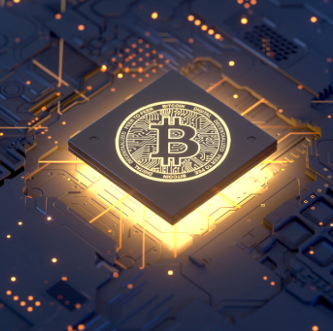
Bitcoin, Blockchain & Cryptocurrency: In simple terms
Momin Quddus
Senior Member, IEEE
This work was done as a private venture and not in the author's capacity as an employee of the Jet Propulsion Laboratory, California Institute of Technology.

Slide 3
Recording:
https://youtu.be/I-9cvFV2c3g

Slide 4
Significant Interest in Bitcoins There has been a lot of interest in Bitcoins from various segments of our economy. Namely,
General Public
Investors & Traders
Financial Markets (Dow, NASDAQ, Coinbase etc)
Corporations (Tesla and others)
Government Officials (Politicians, policy maker, SEC)

Slide 5
Crypto Knowledge gap
1. The Believers
2. The Doubters
3. The Curious
Poll: Please send me the number of the group you think you are in thru the Chat box.

Slide 6
The Believers
These are the people who believe that
Crypto currency will liberate us from the tyranny of the banking system
Crypto Currency will protect our savings from the lack of fiscal discipline of the Government.
Crypto currency will free the free market economy
They trade, create or mine crypto currency
Local Group: “805 Startup, Techies and Entrepreneurs”

Slide 7
The Doubters
These are the people who believe that
Crypto currency is a ‘bunch of hooey’
Crypto Currency is a scam
Crypto currency is a pyramid scheme
Crypto currency is mad science.

Slide 8
The Curious
These are the people who think that
Crypto currency sounds interesting
Would like to know more
This lecture is mostly for this group of people.

Slide 9
In this lecture
In this lecture we will talk about
Crypto Currency
Block Chain
Bitcoin

Slide 10
Crypto currency - Definition
There are five characteristics
of Crypto Currency
Crypto Currency is a digital currency
Currency does not have a physical form
Can be issued by organizations other then Central banks.
It is a peer to peer currency.
It can be transacted without the traditional banking system.

Slide 11
Crypto currency - example
Well known example of crypto currency are,
Airline miles: Used to purchase airline tickets , magazines etc.
Credit card points: Can be used to purchase products thru the credit cards.
Timeshare points (Hilton Timeshare etc): Used to purchase hotel stay, cruise tickets etc.

Slide 12
Imagine This
All the shops and vendors shared a point system.
Consumers could accumulate points by eating in restaurants and then use those points to buy a pair of shoe.
Or you could get points from grocery shopping and use those points to buy gas.
Well, this already exists. You can use Vons points to get discount on gas from Chevron gas station.
So, we already use a form of cryto currency in our day to day lives.
The objective of Cryto currency of today is to make it a more ubiquitous currency.

Slide 13
Now Imagine this
You own a business, say a restaurant.
You want to expand the restaurant. So you need money.
You can go to a bank and take a loan but interest rate is too high.
So you create a investment grade Crypto currency, say ‘XYZ’, backed by a portion of your business as collateral
Investors can purchase the XYZ from your business.
In return investors own part of your business.
Advantage for an investor is they will benefit if your expansion is successful and price of the ‘XYZ’ goes up.
Another advantage is they can sell it to other investors if they want to get out of it.
Advantage for you is you raised funds for expansion without having to take a loan.
You can buy XYZ cryto-currency back from the marketplace if you want to.
The objective of the Crypto currency is to facilitate investments and fund raising.

Slide 14
Question: Do you think Crypto currency will remain open currency once Governments get involved? Answer : Governments get involved in currency regulations for two main reasons. i.e. 1) to collect taxes from transactions and 2) protect the public from fraud. IRS and local governments need a record of transaction so it can collect taxes. Whereas SEC needs to make sure that the investment grade Crypto currency meet a certain standard. Crypto currency ‘Believers’, believe that free market should be free of regulations. The ownership of assessing risk should be on the buyer of the asset and not on a government body. Sooner or later Governments will try to regulate the currencies.

Slide 15
Block Chain - Definition
A blockchain is a growing list of records called blocks which are interconnected by utilizing cryptography.
Blockchain is a type of database.
To understand Block Chain we need to understand Database.

Slide 16
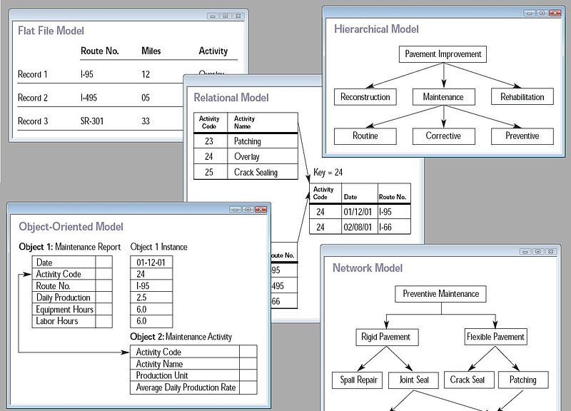
Database
A database is an organized collection of data, generally stored and accessed electronically from a computer system

Slide 17
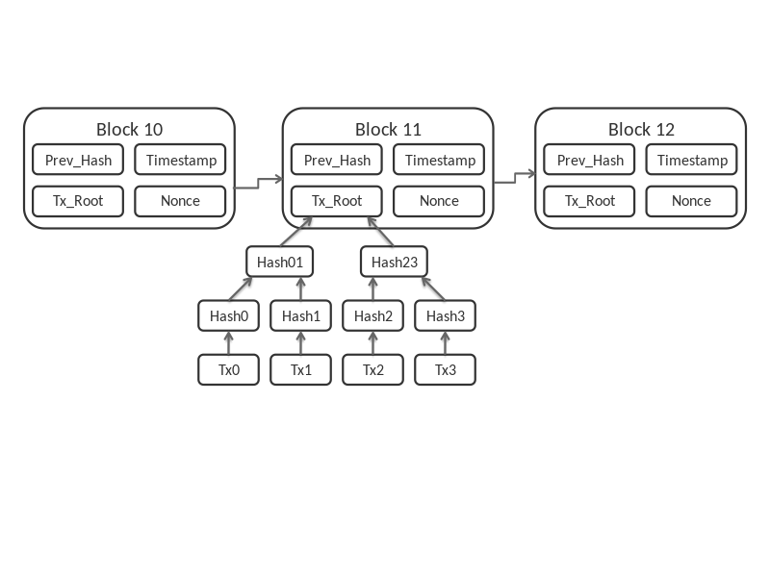
Block Chain - Diagram
Each block contains a cryptographic hash of the previous block, a time stamp, and exchange information. Utilizing blockchain we can safely store information over the shared system, where everybody can see but can’t do any alteration.

Slide 18
Questions ?/ Discussion

Slide 19
Bitcoin- Definition
There are five characteristics of bitcoin
Bitcoin is a digital currency
It is a de-centralized currency
It is one of many crypto currencies
Currency for peer to peer transaction
Bypasses the banking system

Slide 20
Bitcoin- Some History
Bit coin was invented by an unknown person with an alias ‘Satoshi Nakamoto’ .
In 2008 Nakamoto wrote a white paper defining the framework of ‘A peer to peer Electronic Cash System’.
In January of 2009 he implemented bitcoin with ‘Open Source Software’.
Bitcoin network was created when Nakamoto mined the starting block of the chain, known as the ‘Genesis Block’.
Embedded in the coinbase of this block was the text, ”The Times 03/Jan/2009 Chancellor on the brink of second bailout of the banks”.

Slide 21
Bitcoin- More History
Rumor has it that Nakamoto was bothered by the fact that central banks were printing money to bail out banks.
In turn central banks and the Governments were devaluing the currencies.
In the process publics savings were being devalued.
Governments were hurting the individuals to help corporations’ bad behavior.
So he wanted to create a currency whose supply was limited.
The currency was decentralized and democratic.
And no one institution had the authority to increase the supply.

Slide 22
Bitcoin- Implementation
In 12 Jan 2009 a person by the name of Hal Finney downloaded the bitcoin software and received 10 bitcoins from Nakamoto.
In 2010 first commercial transaction by bit was recorded when a programmer by the name of Laszlo Hanyecz bought two Papa John’s pizzas for B10,000.
The price of those two pizzas in today’s price of bitcoin was >$500 million.
It is estimated that Satoshi Nakamoto had mined about one million bitcoins before he disappeared in 2010.
The value of Nakamoto’s bitcoins is >$58 billion, making him the 20th richest man in the world.
Before disappearing Nakamoto handed over the network alert key and the control of the code repository to a programmer named Gavin Andersen.

Slide 23
Question: If block chain is open to everyone then the governments should be able to access the records and track the transactions. Answer: The crypto currencies are essentially numbers. The ownership of the currency is held by cryto-wallets which are also numbers. The transactions happen between wallets. Personal information of the owner of the wallet is not recorded.

Slide 24
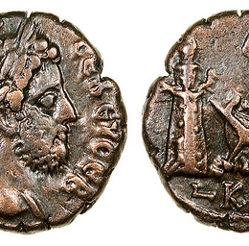
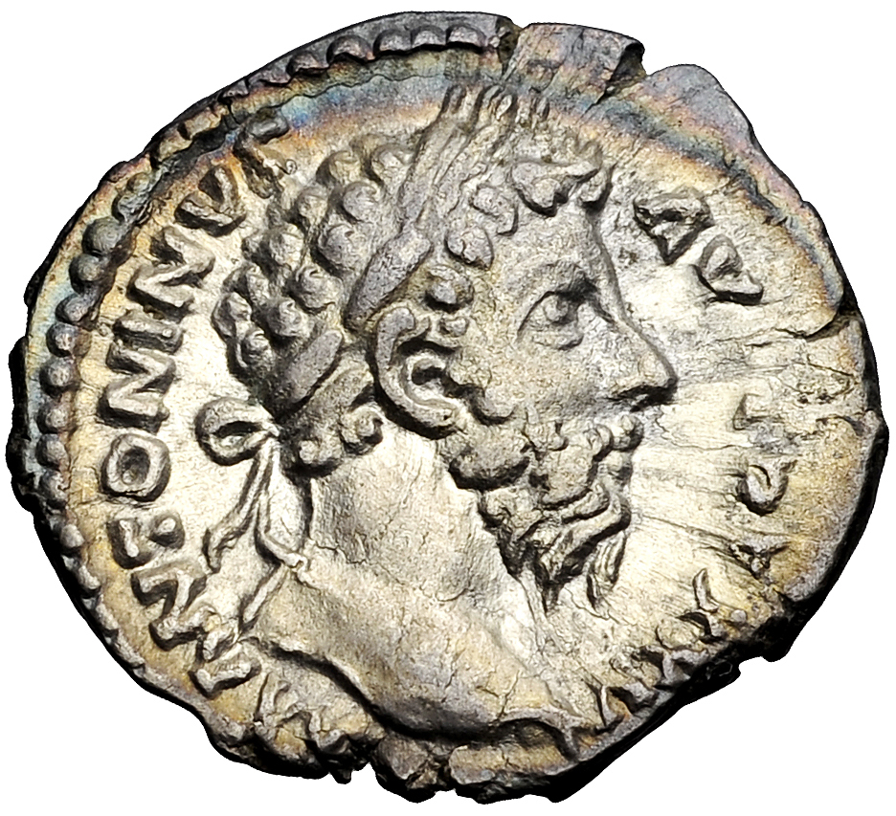
How is Money Created
In ancient civilizations money was created to facilitate exchange of goods , trade and commerce.
Egyptian and Persian kings minted gold and silver coins with their likeness.
Coins had value because they were guaranteed by the kings that they will be accepted throughout the kingdom.
In modern times money is created by Governments thru the constitution.
In US, money is minted by Department of Treasury.
The supply of money determined by the Federal Reserve
In Europe, Central Banks control the money supply.

Slide 25
How is Bit Coin Created
Bitcoin is created by the operation called Bitcoin mining.
Mining is a record-keeping service done through the use of computer processing power.^{[f]}
Miners keep the blockchain consistent, complete, and unalterable by repeatedly grouping newly broadcast transactions into a block.
Miner provide a service to the Bitcoin ecosystem.
In return they are rewarded (paid) with bitcoins.
Total supply of bitcoin is limited to 21 million by the bitcoin algorithm.

Slide 26
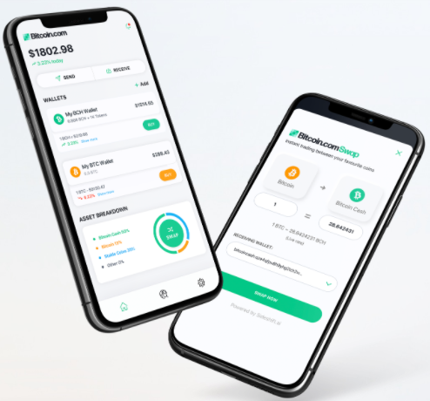
How to own Bitcoin
Create a bitcoin wallet by downloading an App to your device from: https://wallet.bitcoin.com/
The app will generate a bitcoin address.
Acquire bitcoin by purchasing it.
Earn bitcoin by accepting it as payment for goods or services.

Slide 27
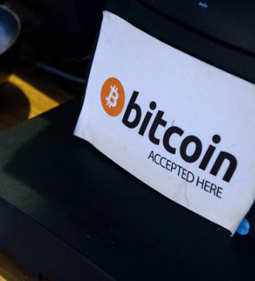
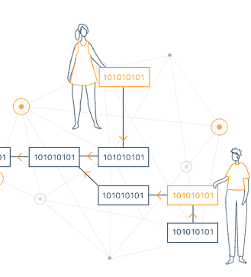
How is Bitcoin transacted
A transaction is a transfer of value between Bitcoin wallets that gets included in the block.
Disclose your bitcoin address to businesses or people you plan to pay or receive payment from.
Bitcoin wallets keep a secret piece of data called a private key or seed, which is used to sign transactions, providing a mathematical proof that they have come from the owner of the wallet.
The signature also prevents the transaction from being altered by anybody once it has been issued.
All transactions are broadcast to the network and usually begin to be confirmed within 10-20 minutes, through a process called mining.

Slide 28
Questions: Governments give value to a currency by guaranteeing its acceptance. How is the value of Cryto-currency created. Answer: Value of Cryto currency is created by the marketplace. Its value increases by its acceptance by the market. An example is when Tesla announced that it will accept Bitcoin as payment for it cars the value of Bitcoin went up.

Slide 29
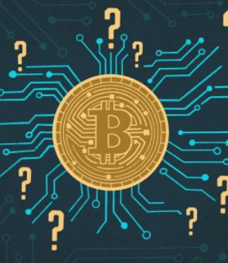
Investment Opportunities in Bitcoin related assets
Bitcoins: Can be brought thru bit coin wallets.
Bitcoin Mining Companies
Companies that provide Bitcoin trading platforms
Bitcoin Trusts
Bitcoin ETFs

Slide 30
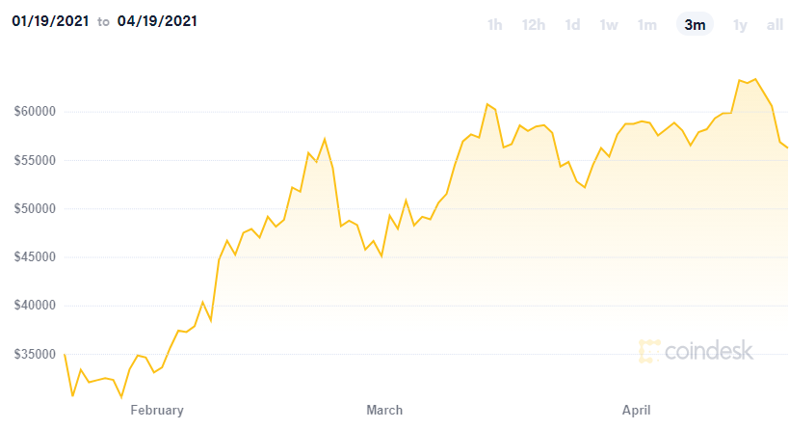
Bitcoin

Slide 31
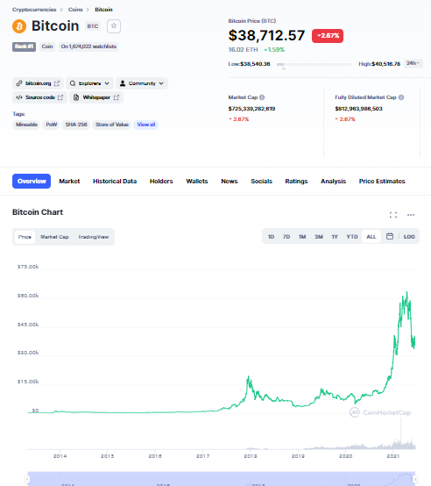

Slide 32
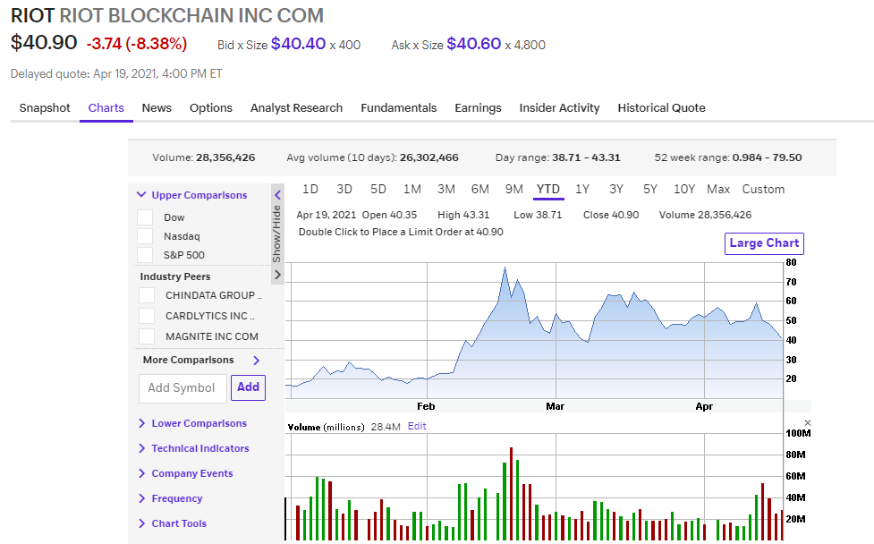
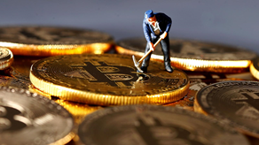
Bitcoin Mining Companies

Slide 33
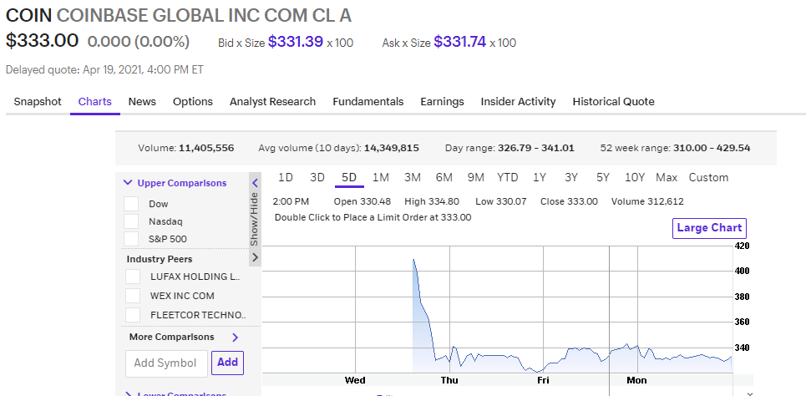
Bitcoin Platform Companies

Slide 34
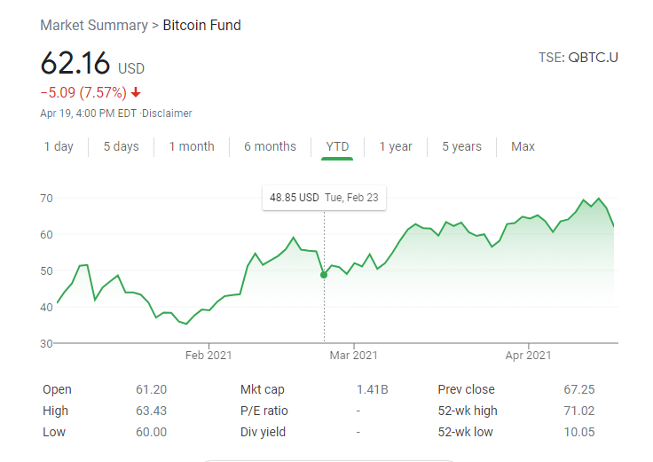
Bitcoin ETFs-Exchange Trade Funds

Slide 35
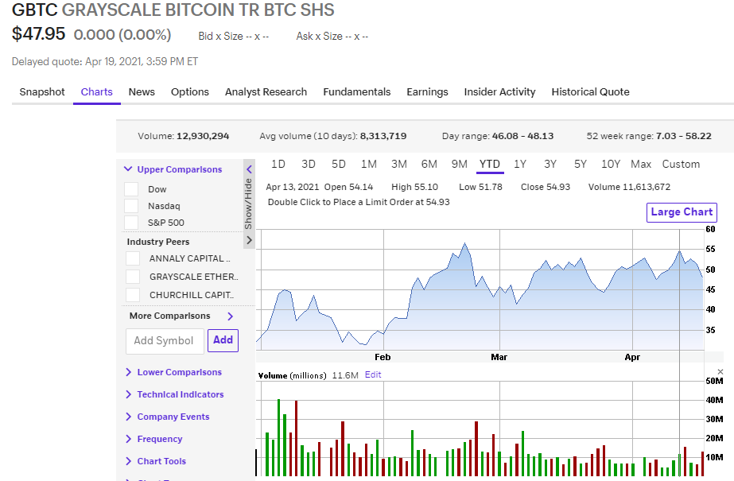
Bitcoin Trusts

Slide 36
Other Crypto Currencies
Ethereum – ETH
Bitcoin Cash – BCH
Litecoin
Chainlink – LINK
Dogecoin-Doge

Slide 37
Questions: Can bitcoin be mined with Personal Computers Answer: In the beginning it was possible to mine bitcoin with PCs. Now the blockchain has become very large and complicated, so it required fast computers (Many parallel processors) with large memory banks to mine bitcoin.

Slide 38
Other Crypto Currencies
Questions: How much energy does it take to mine a bit coin
Ethereum – ETH
Bitcoin Cash – BCH
Litecoin
Chainlink – LINK
Dogecoin-Doge

Slide 39
Questions: How much energy does it take to mine a bit coin Answer:
Bitcoin system consumes 32-63 TWH of energy per year.
That is greater than energy consumption of Argentina per year. Litecoin
That is equal to energy produced by 50K wind turbines at peak production of electricity.
18.5 Million Bitcoins have been mined to date.
302400 Bitcoins were mined in 2018.
100-200 MWh of energy is consumed to mine each Bitcoin
At highest retail energy cost in California of 0.28c/kWh, the cost of electricity/Bitcoin mining is $28k-56k.

