Slide 1
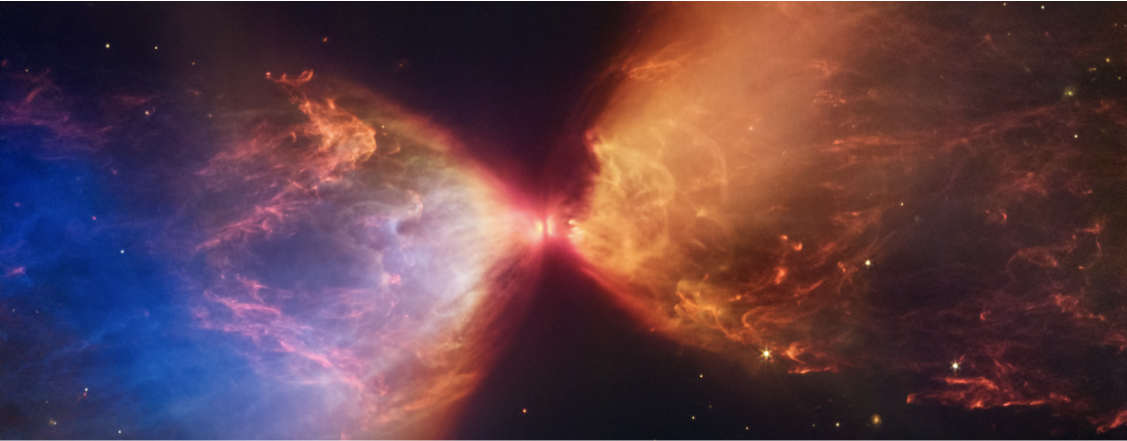
Studying Protoplanetary Disks To Understand Planet Formation
Marion Villenave

Slide 2
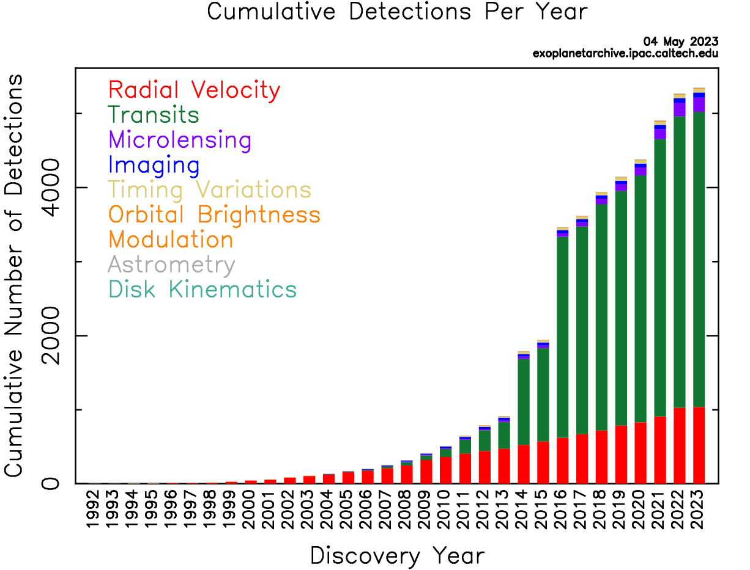
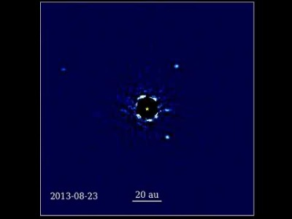
Number of exoplanets discovered (and counting)
HR8799 system
Video from J. Wang

Slide 3
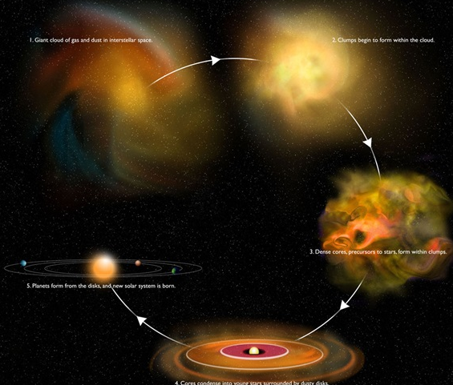
Star and planet formation
Molecular cloud
Clump formation
Protoplanetary disks
A stage of star formation
Planets are thought to form in the disk phase
Protostellar cores
Exoplanet systems
Protoplanetary disks

Slide 4
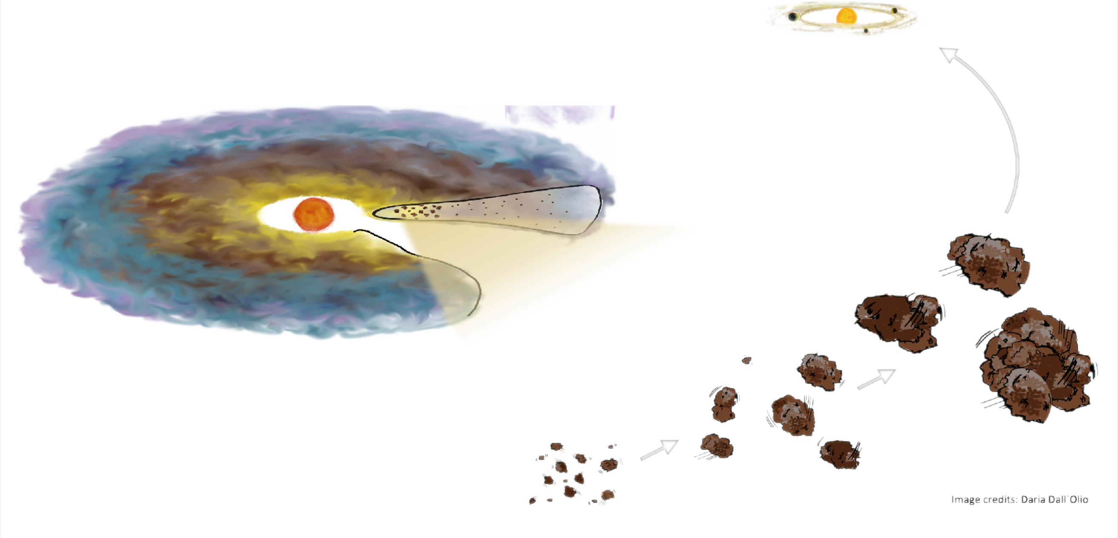
Planet formation
Starts by the growth of µm sized dust, into pebbles, and finally planetesimals and planets
Occurs before the disk dissipates
Image credit: Daria Dall’Olio
~ few Myr
Needs to be efficient
Grain growth is faster for large dust density
Notes:
Mention pebble accretion

Slide 5
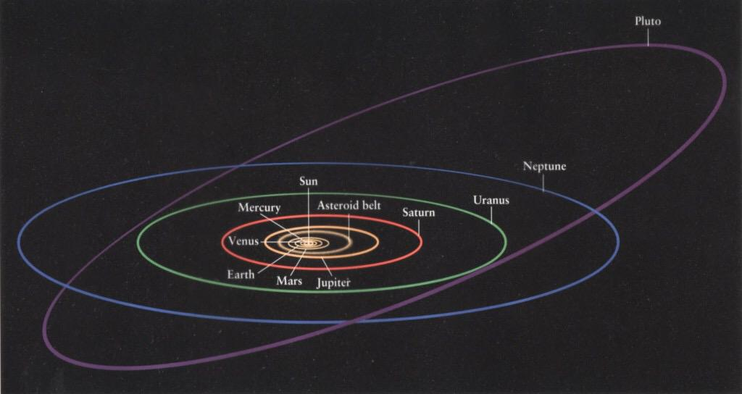
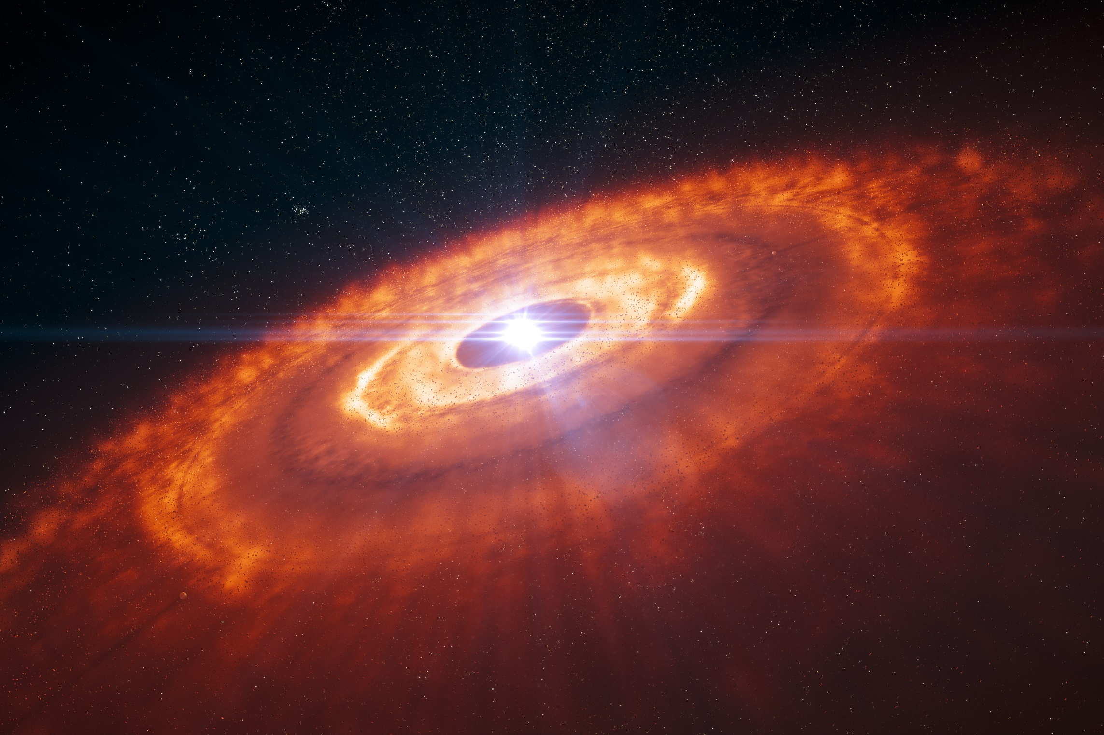
Size of a protoplanetary disk
Big ! In most cases much larger than the solar system
au: astronomical units = Distance Earth - Sun
30au
300au
Notes:
Evolution mechanisms of the dust in protoplanetary disks:
Radial drift: bad for planet formation because it removes dust from the disk
Vertical settling: good for planet formation because it accumulates dust in the midplane of disks

Slide 6
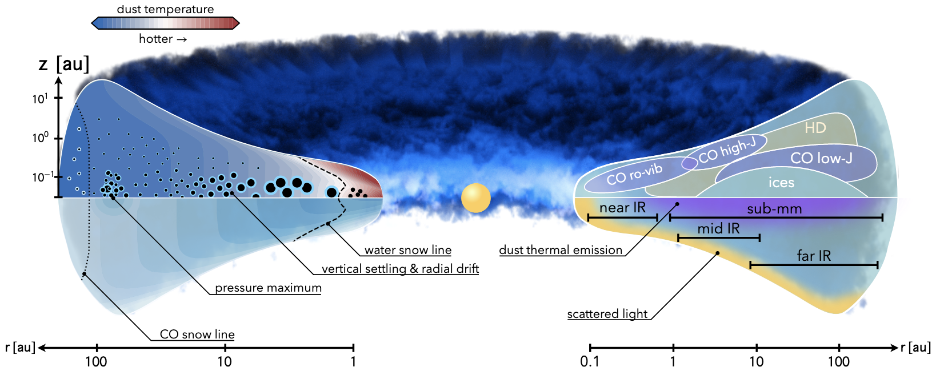

Structure of a protoplanetary disk
Dust interaction with the surrounding gas
Gas amounts for 99% of the mass in a disk
Gas slows dust down and makes it fall into the disk midplane and drift radially
Density
Miotello et al. 2022
Vertical
settling
Radial drift
Notes:
Evolution mechanisms of the dust in protoplanetary disks:
Radial drift: bad for planet formation because it removes dust from the disk
Vertical settling: good for planet formation because it accumulates dust in the midplane of disks

Slide 7
Structure of a protoplanetary disk
Dust interaction with the surrounding gas
Gas amounts for 99% of the mass in a disk
Gas slows dust down and makes it fall into the disk midplane and drift radially
Density
Miotello et al. 2022
Vertical
settling
Radial drift
Notes:
Evolution mechanisms of the dust in protoplanetary disks:
Radial drift: bad for planet formation because it removes dust from the disk
Vertical settling: good for planet formation because it accumulates dust in the midplane of disks

Slide 8
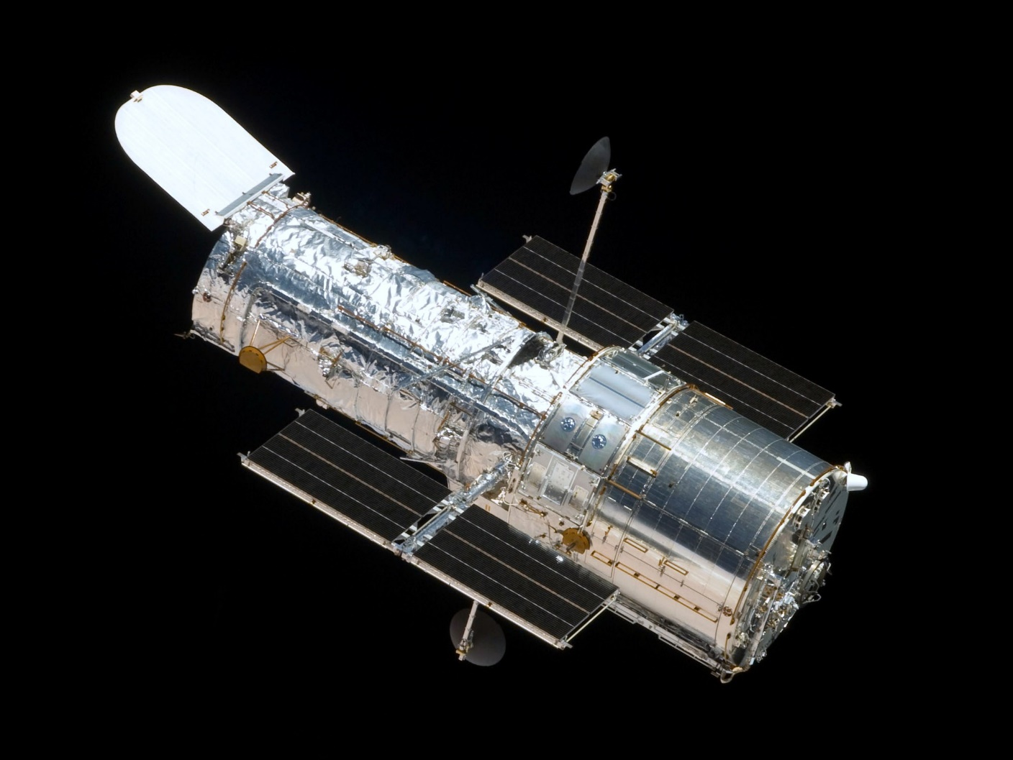
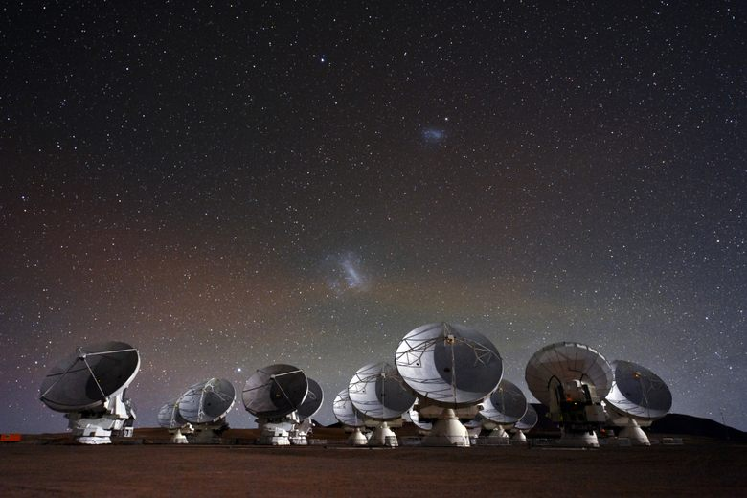
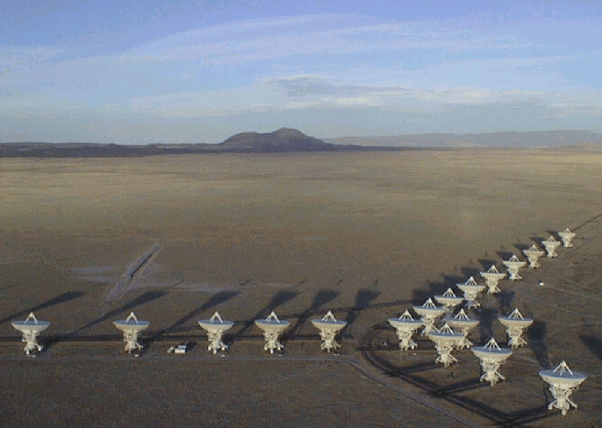
Multi-wavelength observations
Hubble Space Telescope
ALMA
VLA
0.1 – 2.5 µm
CCD
Scattered light observations from ~µm sized particles
Well coupled to the gas
0.3 – 3.6 mm
Heterodyne detectors
Thermal emission from
~100µm sized particles
Affected by vertical settling
6 – 4100 mm
Heterodyne detectors
Thermal emission from
~mm sized particles
(+ free-free emission)
Affected by vertical settling

Slide 9
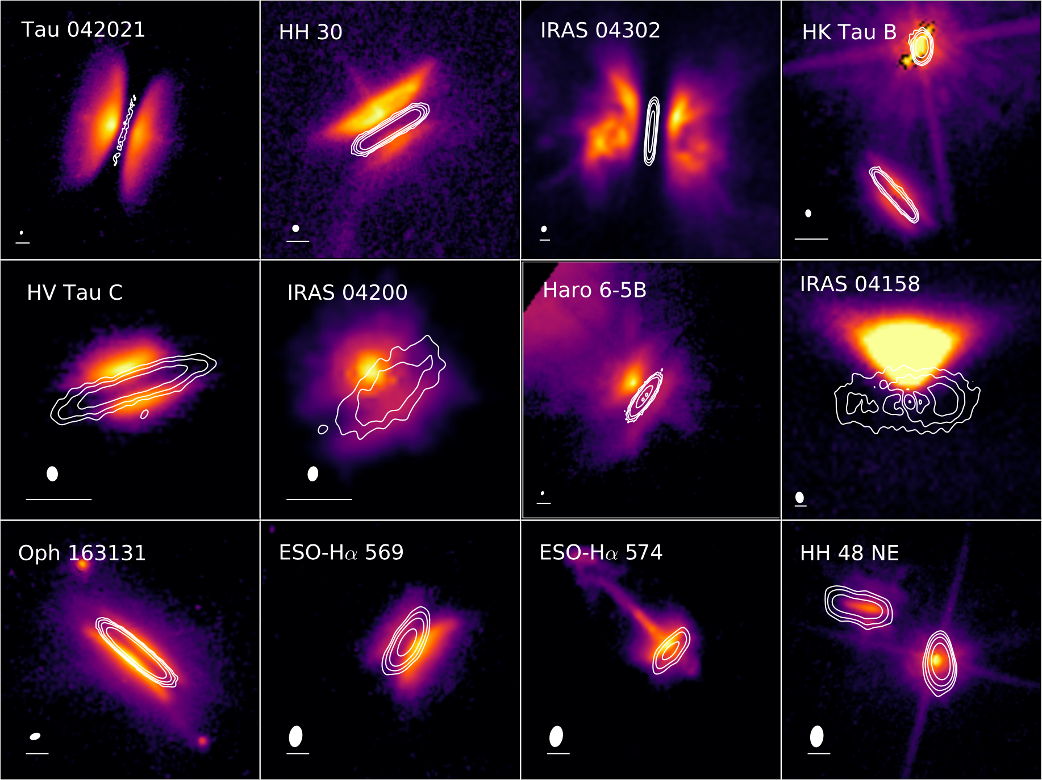
Observations of IRAS04302
Padgett et al. 1999, Villenave et al. 2020, 2023
Hubble Space Telescope
ALMA
VLA
1.6µm
Observations at a variety of wavelengths – sensitive to grains of different sizes
HST image: probe µm sized dust, shows the presence of an envelope

Slide 10
Observations of IRAS04302
Padgett et al. 1999, Villenave et al. 2020, 2023
Hubble Space Telescope
ALMA
VLA
1.6µm
0.9mm
Observations at a variety of wavelengths – sensitive to grains of different sizes
HST image: probe µm sized dust, shows the presence of an envelope
ALMA image: probe ~100µm sized dust, less extended in the vertical direction than the HST observations

Slide 11
Observations of IRAS04302
Padgett et al. 1999, Villenave et al. 2020, 2023
Hubble Space Telescope
ALMA
VLA
1.6µm
0.9mm
2.1mm
Observations at a variety of wavelengths – sensitive to grains of different sizes
HST image: probe µm sized dust, shows the presence of an envelope
ALMA image: probe ~100µm sized dust, less extended in the vertical direction than the HST observations

Slide 12
Observations of IRAS04302
Padgett et al. 1999, Villenave et al. 2020, 2023
Hubble Space Telescope
ALMA
VLA
1.6µm
0.9mm
2.1mm
9.2mm
Observations at a variety of wavelengths – sensitive to grains of different sizes
HST image: probe µm sized dust, shows the presence of an envelope
ALMA image: probe ~100µm sized dust, less extended in the vertical direction than the HST observations
VLA image: probe mm sized dust, significantly more radially compact than the ALMA observations

Slide 13
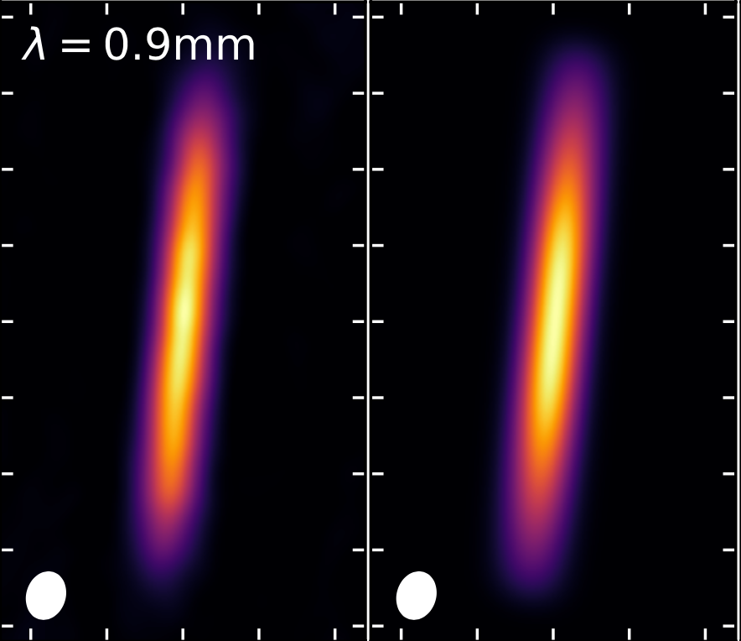
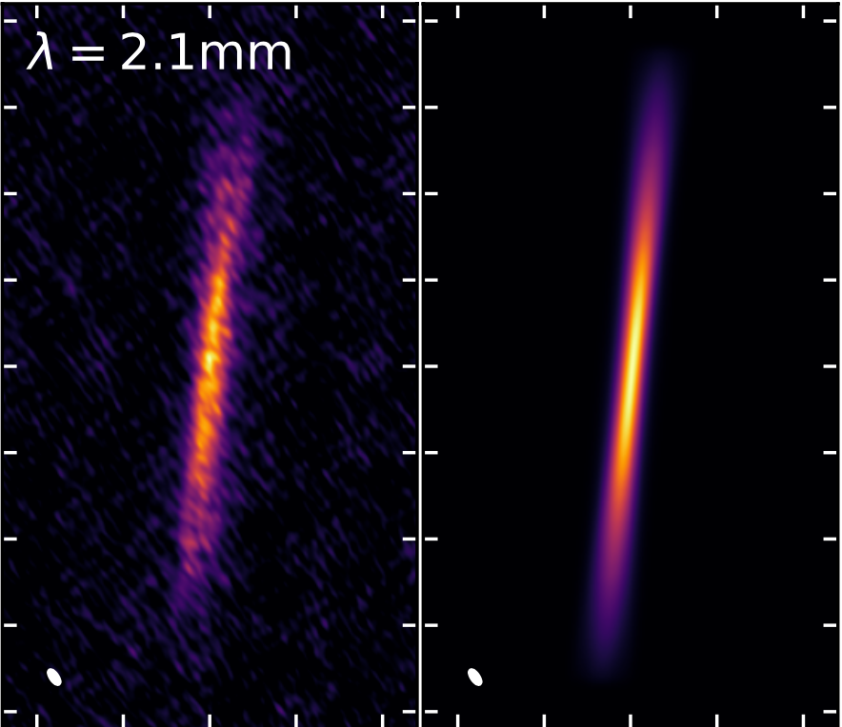
Constraints on the height of the mm dust
Model with dust height of 3au at 100au
Minor axis cuts
Data
Villenave et al. 2023
Lower limit on the vertical extent of large dust
Models with H_{d, 100au} = 1au: too thick at 2.1mm – first lower limit for dust scale height in the mm
Models with H_{d, 100au} = 6au: too thick at 0.9mm – suggestive of some level of vertical settling
1au = 1 astronomical unit = Distance Earth-Sun

Slide 14
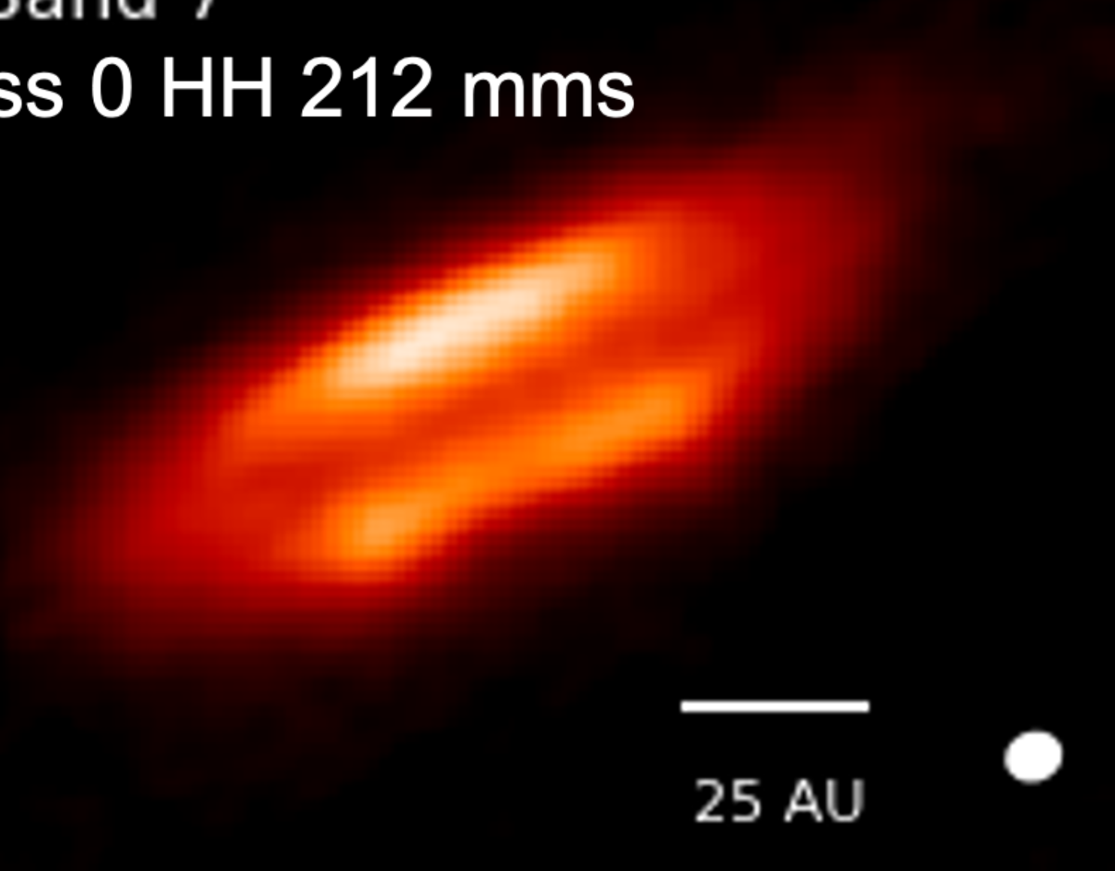
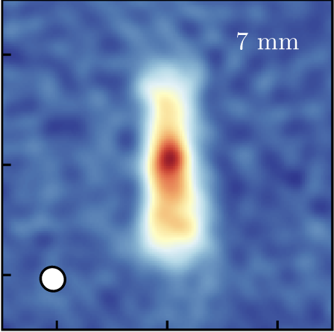
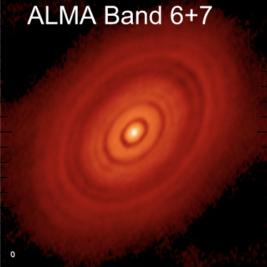
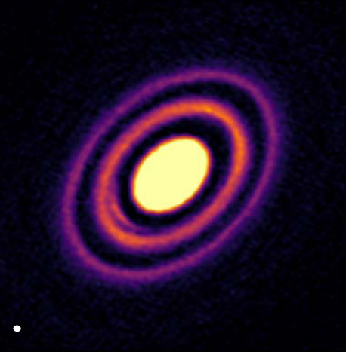
Evolutionary sequence of vertical settling?
Very young and embedded
Young
Evolved
Age < 0.3 Myr
Vertically thick
0.3 < Age < 0.5 Myr
H_{1mm}>1 au at 100au
0.5 < Age < 10 Myr
H_{1mm}<1 au at 100au
HH212 – 0.9mm
IRAS04302+2247 - 2.1mm
Oph163131 – 1.3mm
HH30 – 0.9mm & 0.8µm
L1527 – 7mm
HL Tau – 1mm
HD163296 – 1.3mm
Lee et al. 2017; Lin et al. 2021; Sheehan et al. 2022
Villenave et al. 2023
See also Lin et al. submitted
Villenave et al. 2020; 2022, Pinte et al. 2016; Doi & Kataoka 2021; Liu et al. 2022
1 Myr = 1 million year
1au = 1 astronomical unit = Distance Earth-Sun

Slide 15
Implications for planet formation
Dust grains may get more vertically concentrated with disk age
Concentration is favorable for planet formation – accelerates grain growth and pebble accretion
Older disks might be more favorable for efficient planet formation

Slide 16
Implications for planet formation
Dust grains may get more vertically concentrated with disk age
Concentration is favorable for planet formation – accelerates grain growth and pebble accretion
Older disks might be more favorable for efficient planet formation
Do we see planets forming within evolved disks ?
The transformational view of the ALMA interferometer
Extremely high sensitivity and resolution
Wavelengths: 0.3 – 3.6 mm
Thermal emission from ~100µm sized particles

Slide 17
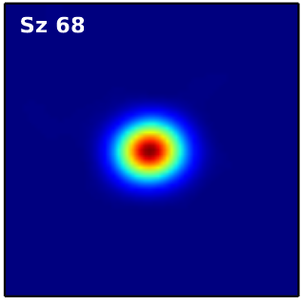
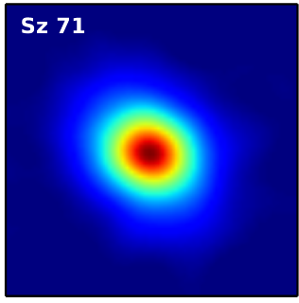
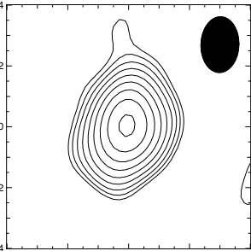
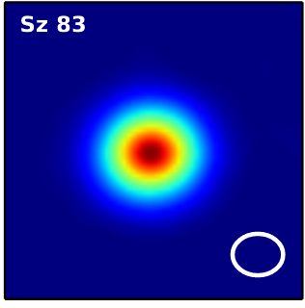
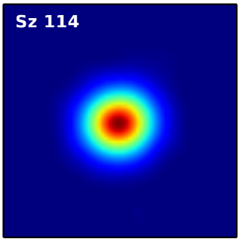
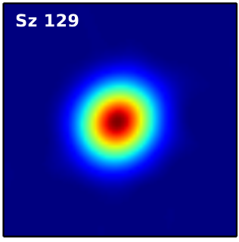
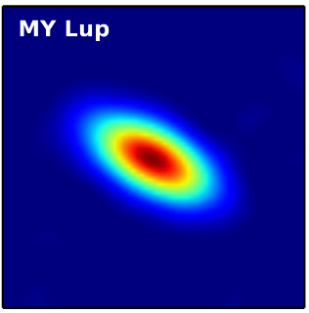
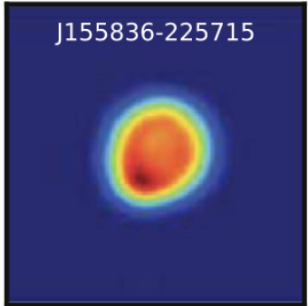
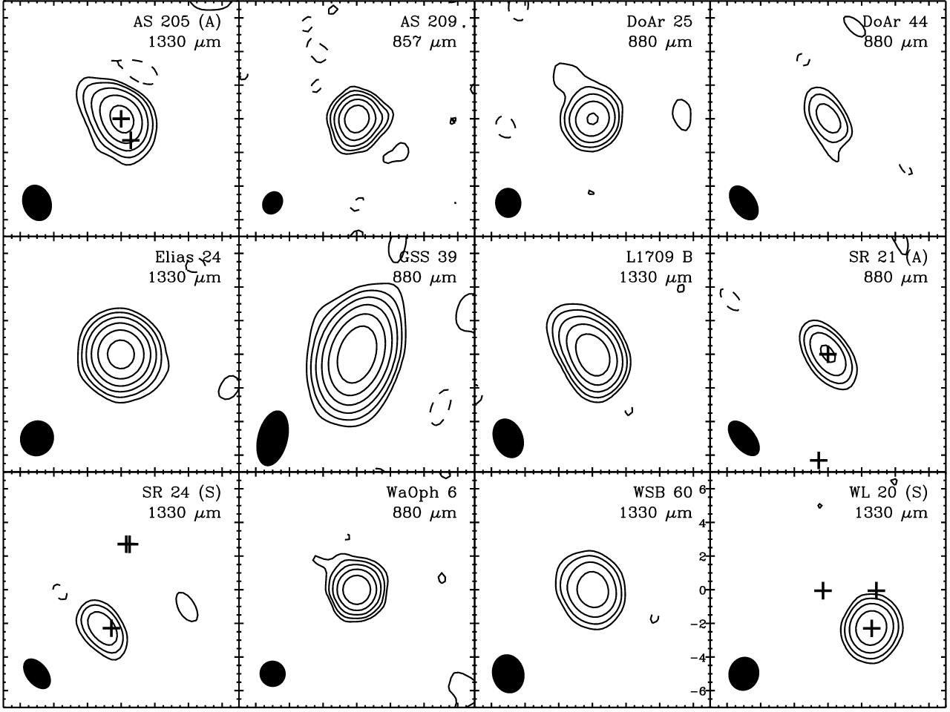
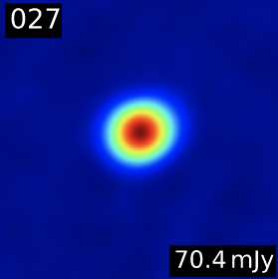
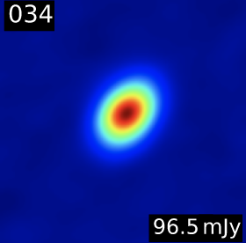
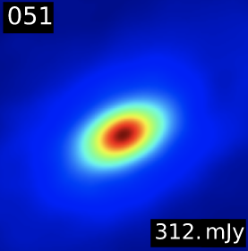
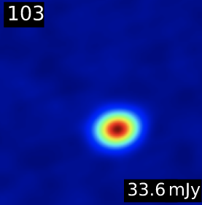
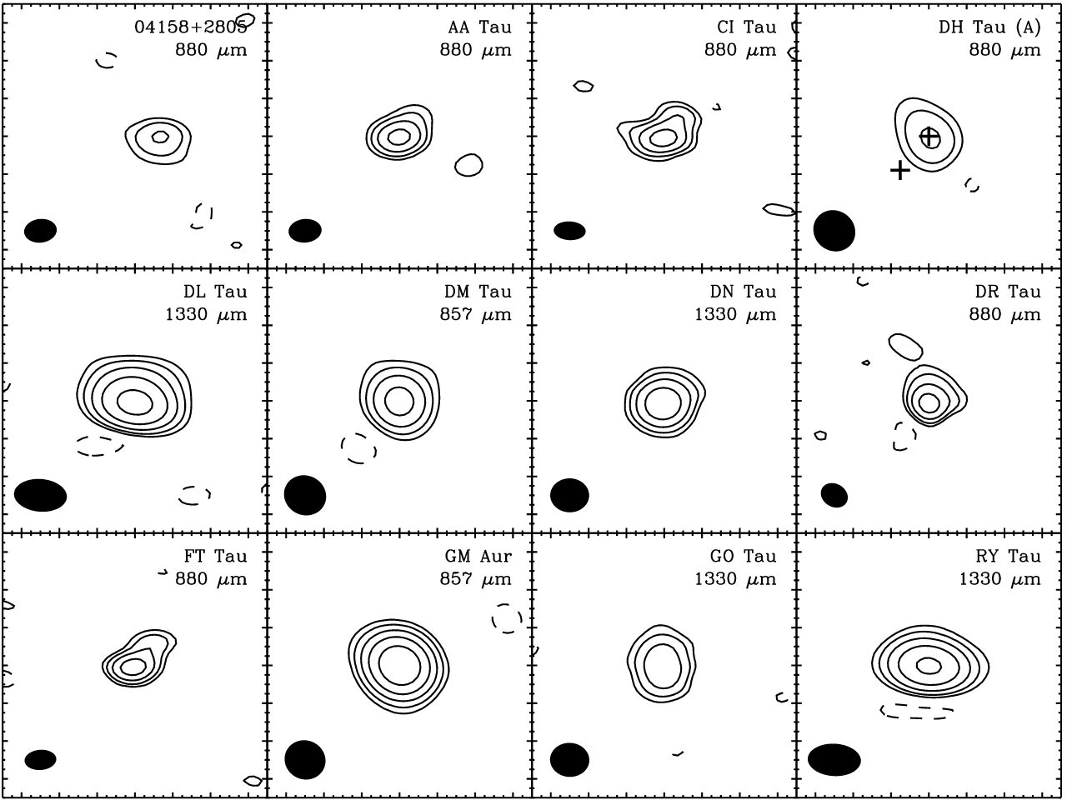
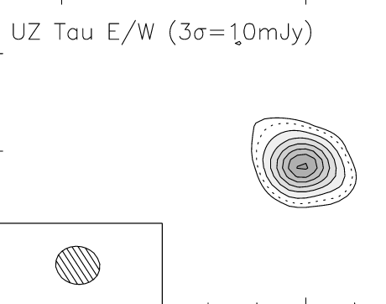
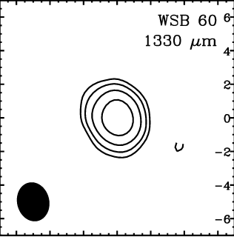
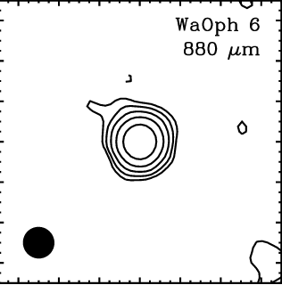
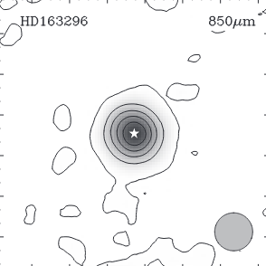
IM Lup
Before high angular resolution ALMA
Smooth disks
Andrews & Williams 2007, Isella et al. 2007, Pinte et al. 2008, Isella et al. 2009, Sandell et al. 2011, Ansdell et al. 2016, Barenfeldt et al. 2016, Cieza et al. 2019

Slide 18
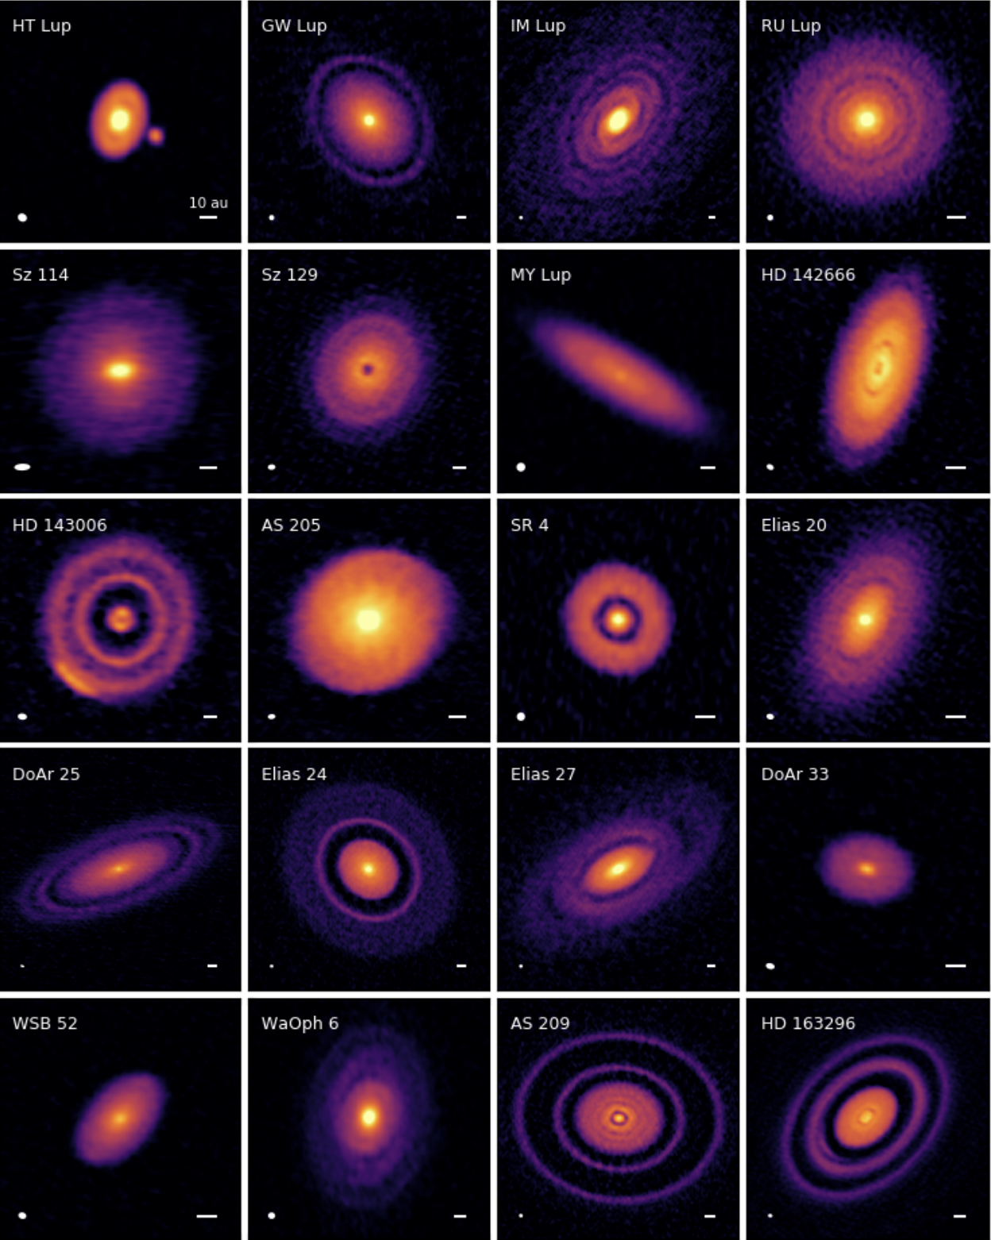
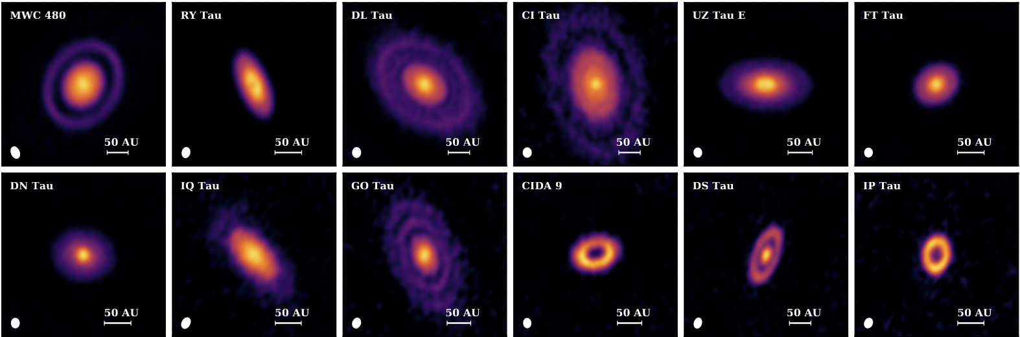
Substructures are ubiquitous
This can be a sign for planet formation
Rings, gaps, spirals, asymmetric accumulations might be caused by planets embedded in the disk
Those could be dust trap and allow grain growth without fast radial drift
Andrews et al. 2018, Long et al. 2018
Notes:
Let’s focus on the potential origin of the cavities of some disks

Slide 19
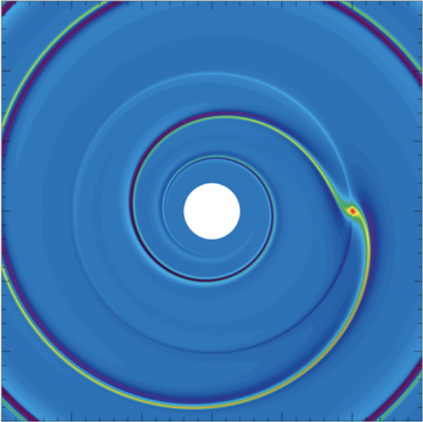
Substructures to infer planet masses
Planets accrete the disk material and open gaps or cavities
Protoplanetary gas disk
Gap opened by the planet
Planet
Star
Baruteau et al. 2013
Zhang et al. 2018

Slide 20
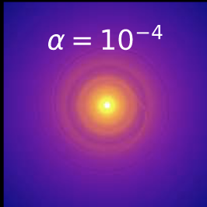
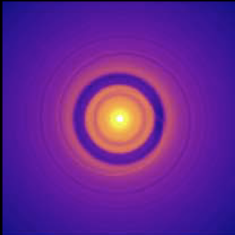
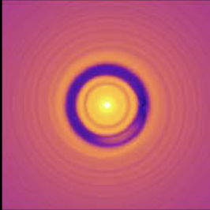
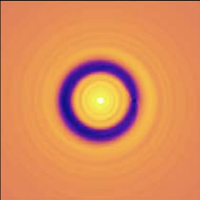
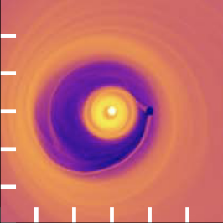
Substructures to infer planet masses
Planets accrete the disk material and open gaps or cavities
The depth of the gap depends on the planet mass
Protoplanetary gas disk
11 M_{Earth}
33 M_{Earth}
0.3 M_{Jupiter}
Gap opened by the planet
Planet
Star
1 M_{Jupiter}
3 M_{Jupiter}
Baruteau et al. 2013
Zhang et al. 2018
Predictions of ALMA observations for different planet masses

Slide 21
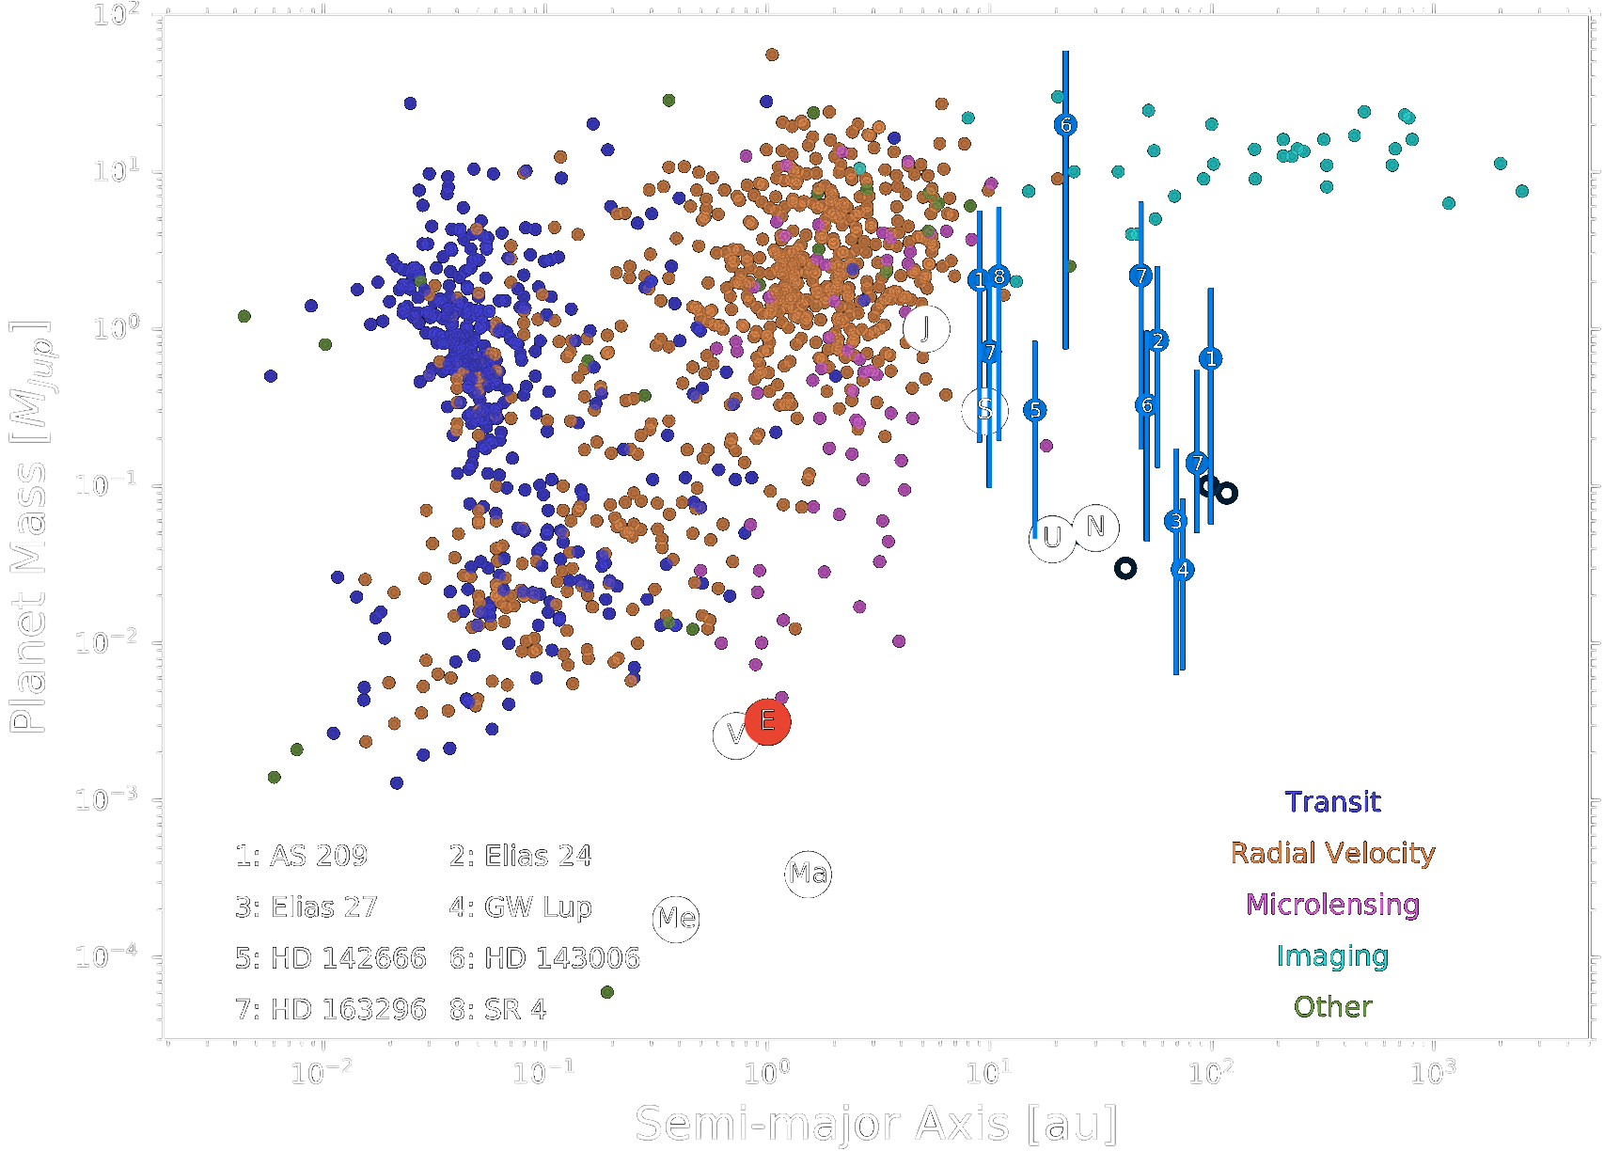
Exoplanet masses based on different observations
ALMA planets probe a different parameter space than other discovery methods
Indirect method – can we confirm the presence of planets in disks using direct detection?
ALMA planets
Zhang et al. 2018

Slide 22
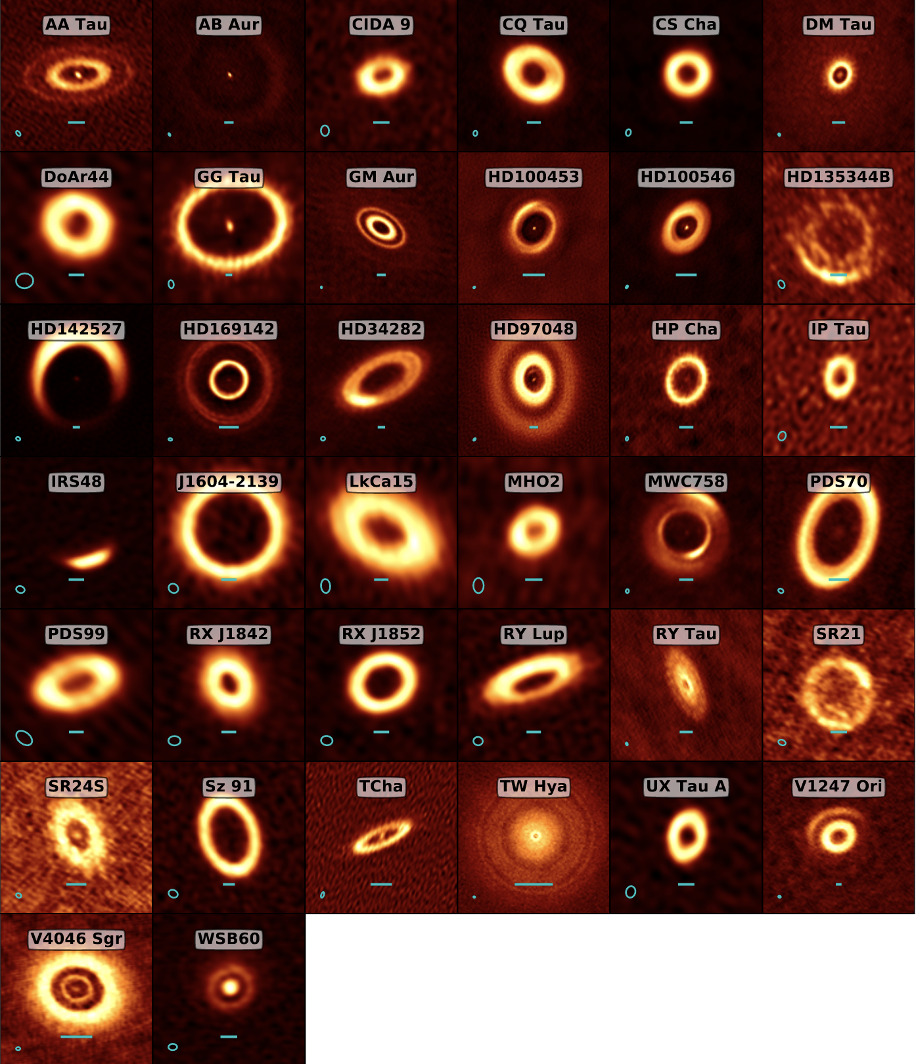
Disks with large cavities
A favorable class of disks to look for planets
Deep cavities in many systems
No dust but some gas inside many cavities
Consistent with being opened by planets
Cavities may also be caused by other scenario
Photoevaporation (Owen et al. 2011)
Dead zones (Flock et al. 2015, Pinilla et al. 2016, Garate et al. 2021) Opacity effect via grain growth (Dullemond&Dominik 2005, Birnstiel et al. 2012)
Francis & van der Marel 2020
Notes:
I would like first to focus on the disks with a large central cavity.
Those can be identified because they have a lack of emission at about 10µm
This lack of emission usually indicates the presence of cavities from few 10 au to 100s of au
And one question is: are the cavities caused by planets or not ?

Slide 23
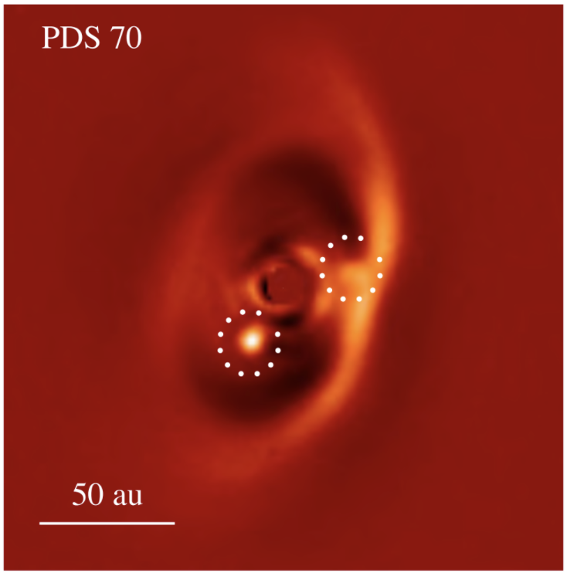
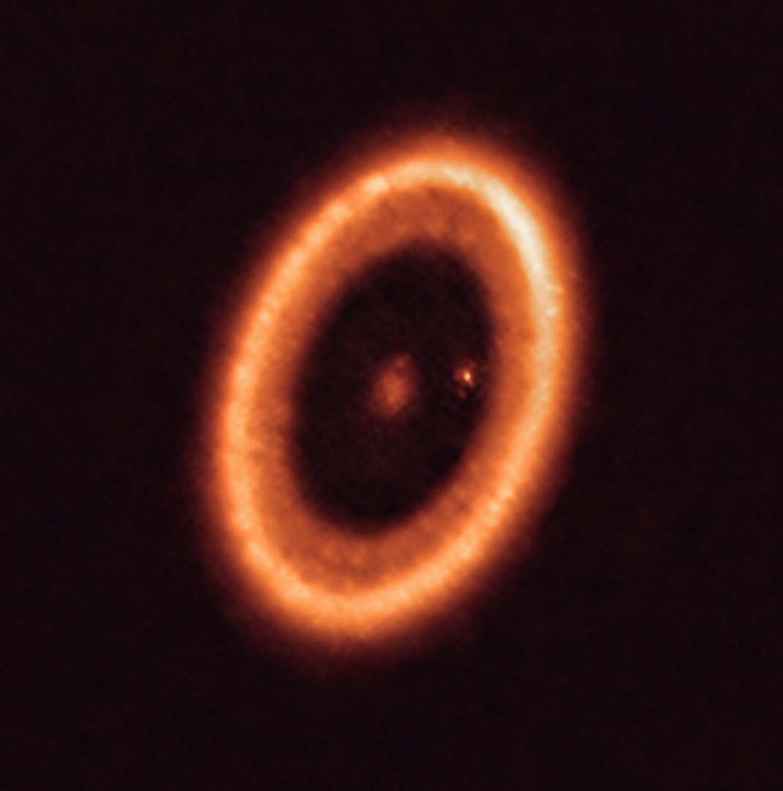
Best (and only) example of planet directly detected within a protoplanetary disk
PDS 70
2 giant planets orbiting inside the cavity of PDS 70
M_{planet} > 10 M_{J} for both
Radius 22 au & 34 au
VLT/SPHERE
IR observations, small grains
ALMA
mm observations, larger grains
Müller et al. 2018, Benisty et al. 2021

Slide 24
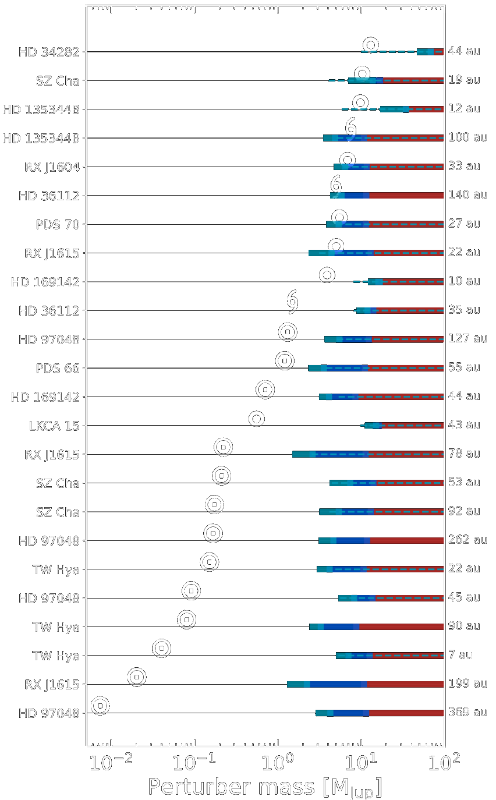
Do we detect planets in protoplanetary disks ?
PDS 70
2 giant planets orbiting inside the cavity of PDS 70
M_{planet} > 10 M_{J} for both
Radius 22 au & 34 au
No: every other disk
Direct images searches have not detected strong evidence of planets in other disks
The predicted planetary masses are still below the capabilities of current instruments
Future instruments (ELTs) would be more sensitive to planets in disks
Asensio-Torres et al. 2021 (incl. Villenave)
Wallack et al. submitted (incl. Villenave)
Notes:
There are also a few indirect detections of planets indicating that they could be creating the gaps, but further direct imaging studies of planets in protoplanetary disks would be important to confirm these indirect candidates.

Slide 25
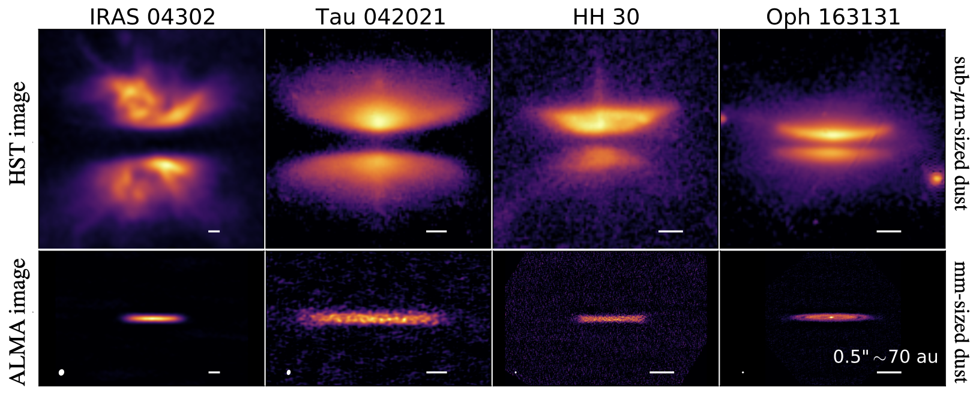
Summary
Multi-wavelengths analysis of protoplanetary disks can reveal the morphology of different grain populations
Planet formation in disks
The many substructures found in disks indicate that planets are already formed at this stage
One example of planet directly observed in a disk – The field is looking for more!
Vertical extent of protoplanetary disks
Dust grains can get more vertically concentrated with disk age
Older disks might be more favorable for efficient planet formation
25

