Slide 1
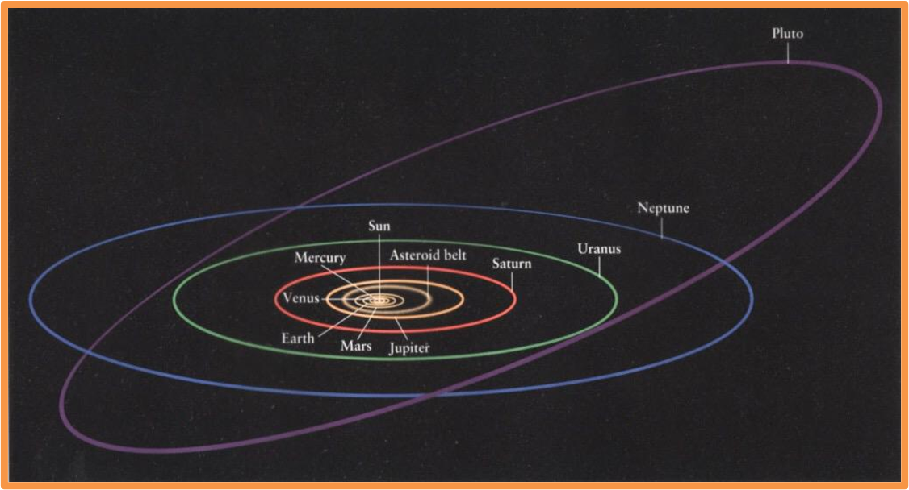
Spring Mixer
2023

Slide 2
First annual Spring Mixer was held at HUB101 of California Lutheran University’s extension campus. The event was attended by 30 IEEE and community members. Dinner was served by Stonefire Grill courtesy of IEEE.
BV Section Chair, Momin Quddus emceed the event. Dr. Marion Vellenave of Jet Propulsion Labs, presented an interesting lecture on Protoplanetary disks to understand Planet formation. The lecture was followed by a vibrant Q & A session. Audience participation was great.

Slide 3
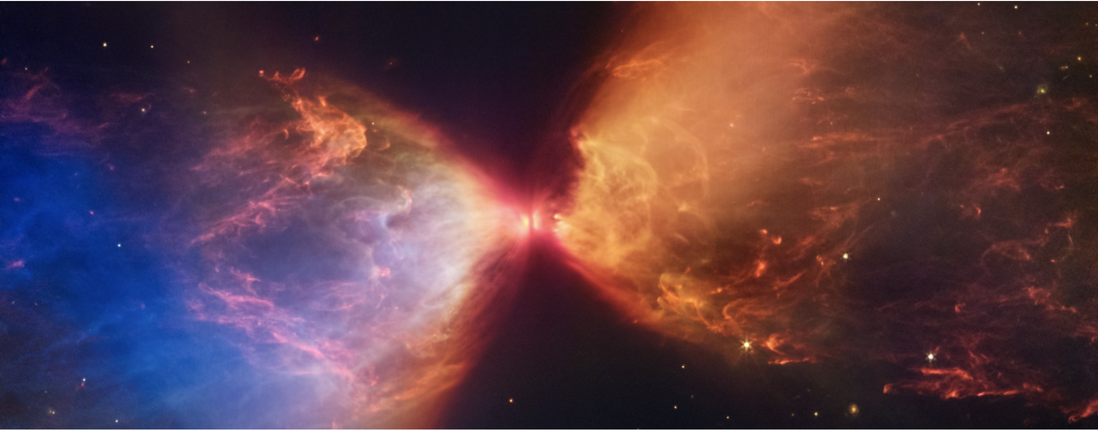
Studying Protoplanetary Disks To Understand Planet Formation
Marion Villenave

Slide 4
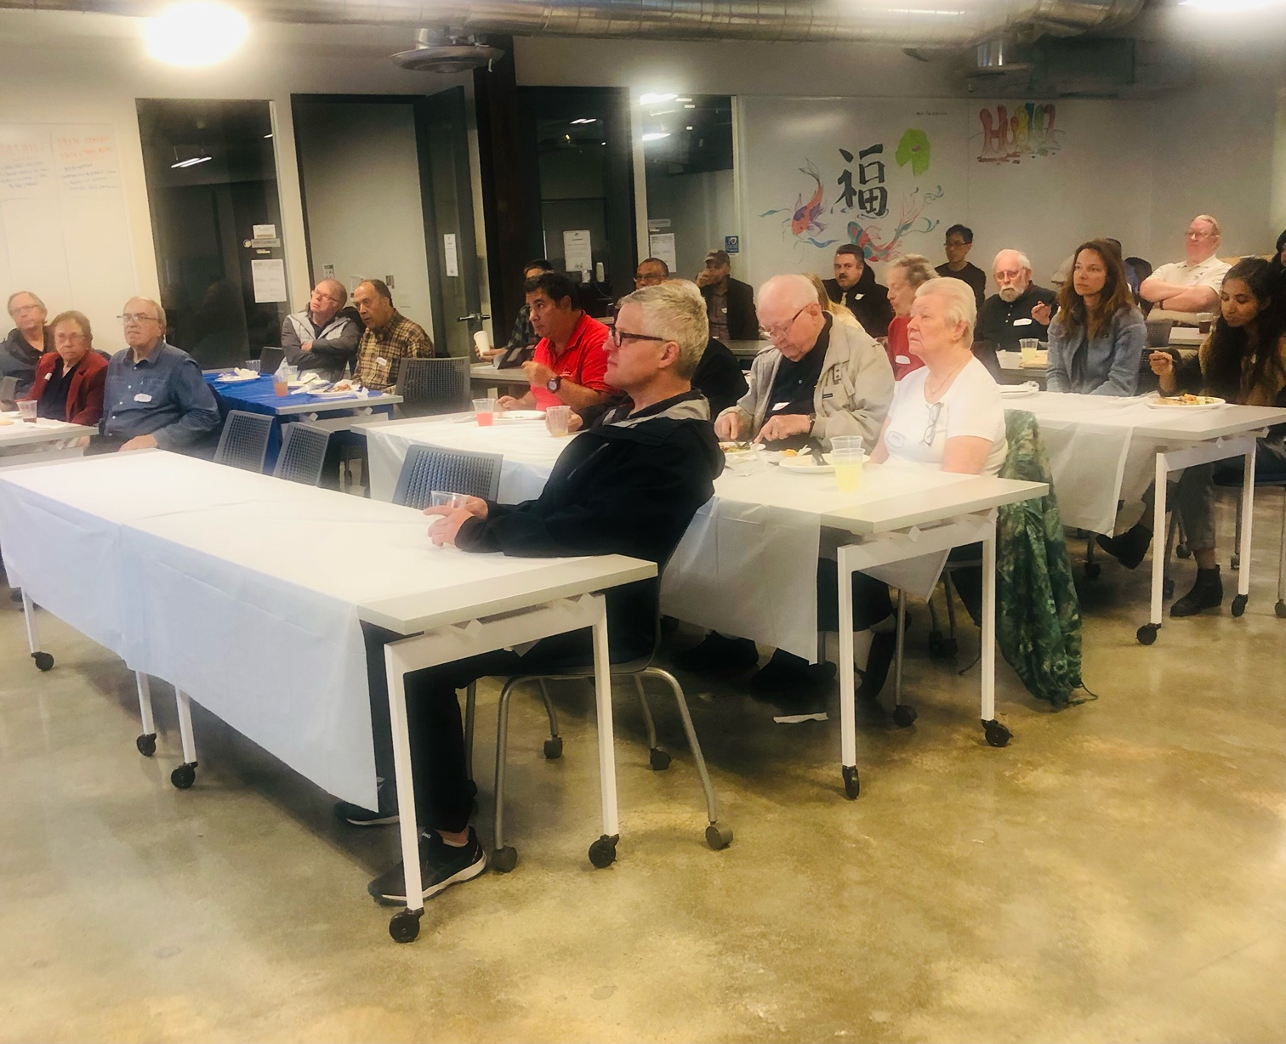

Slide 5
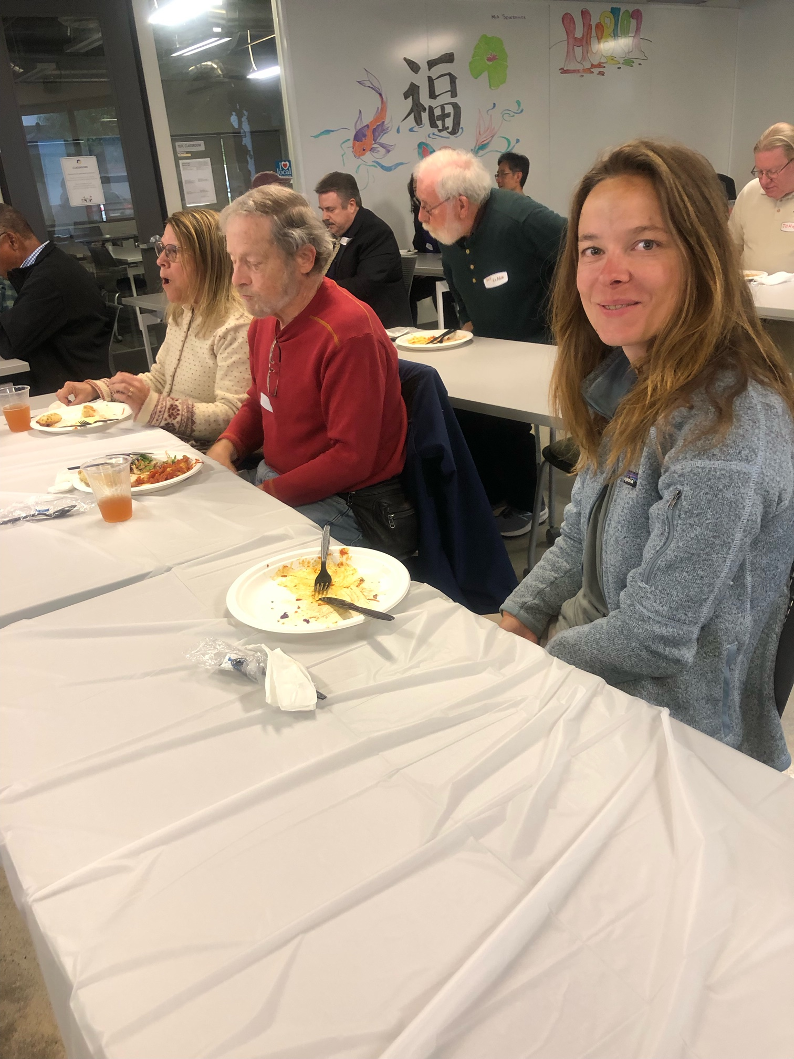

Slide 6
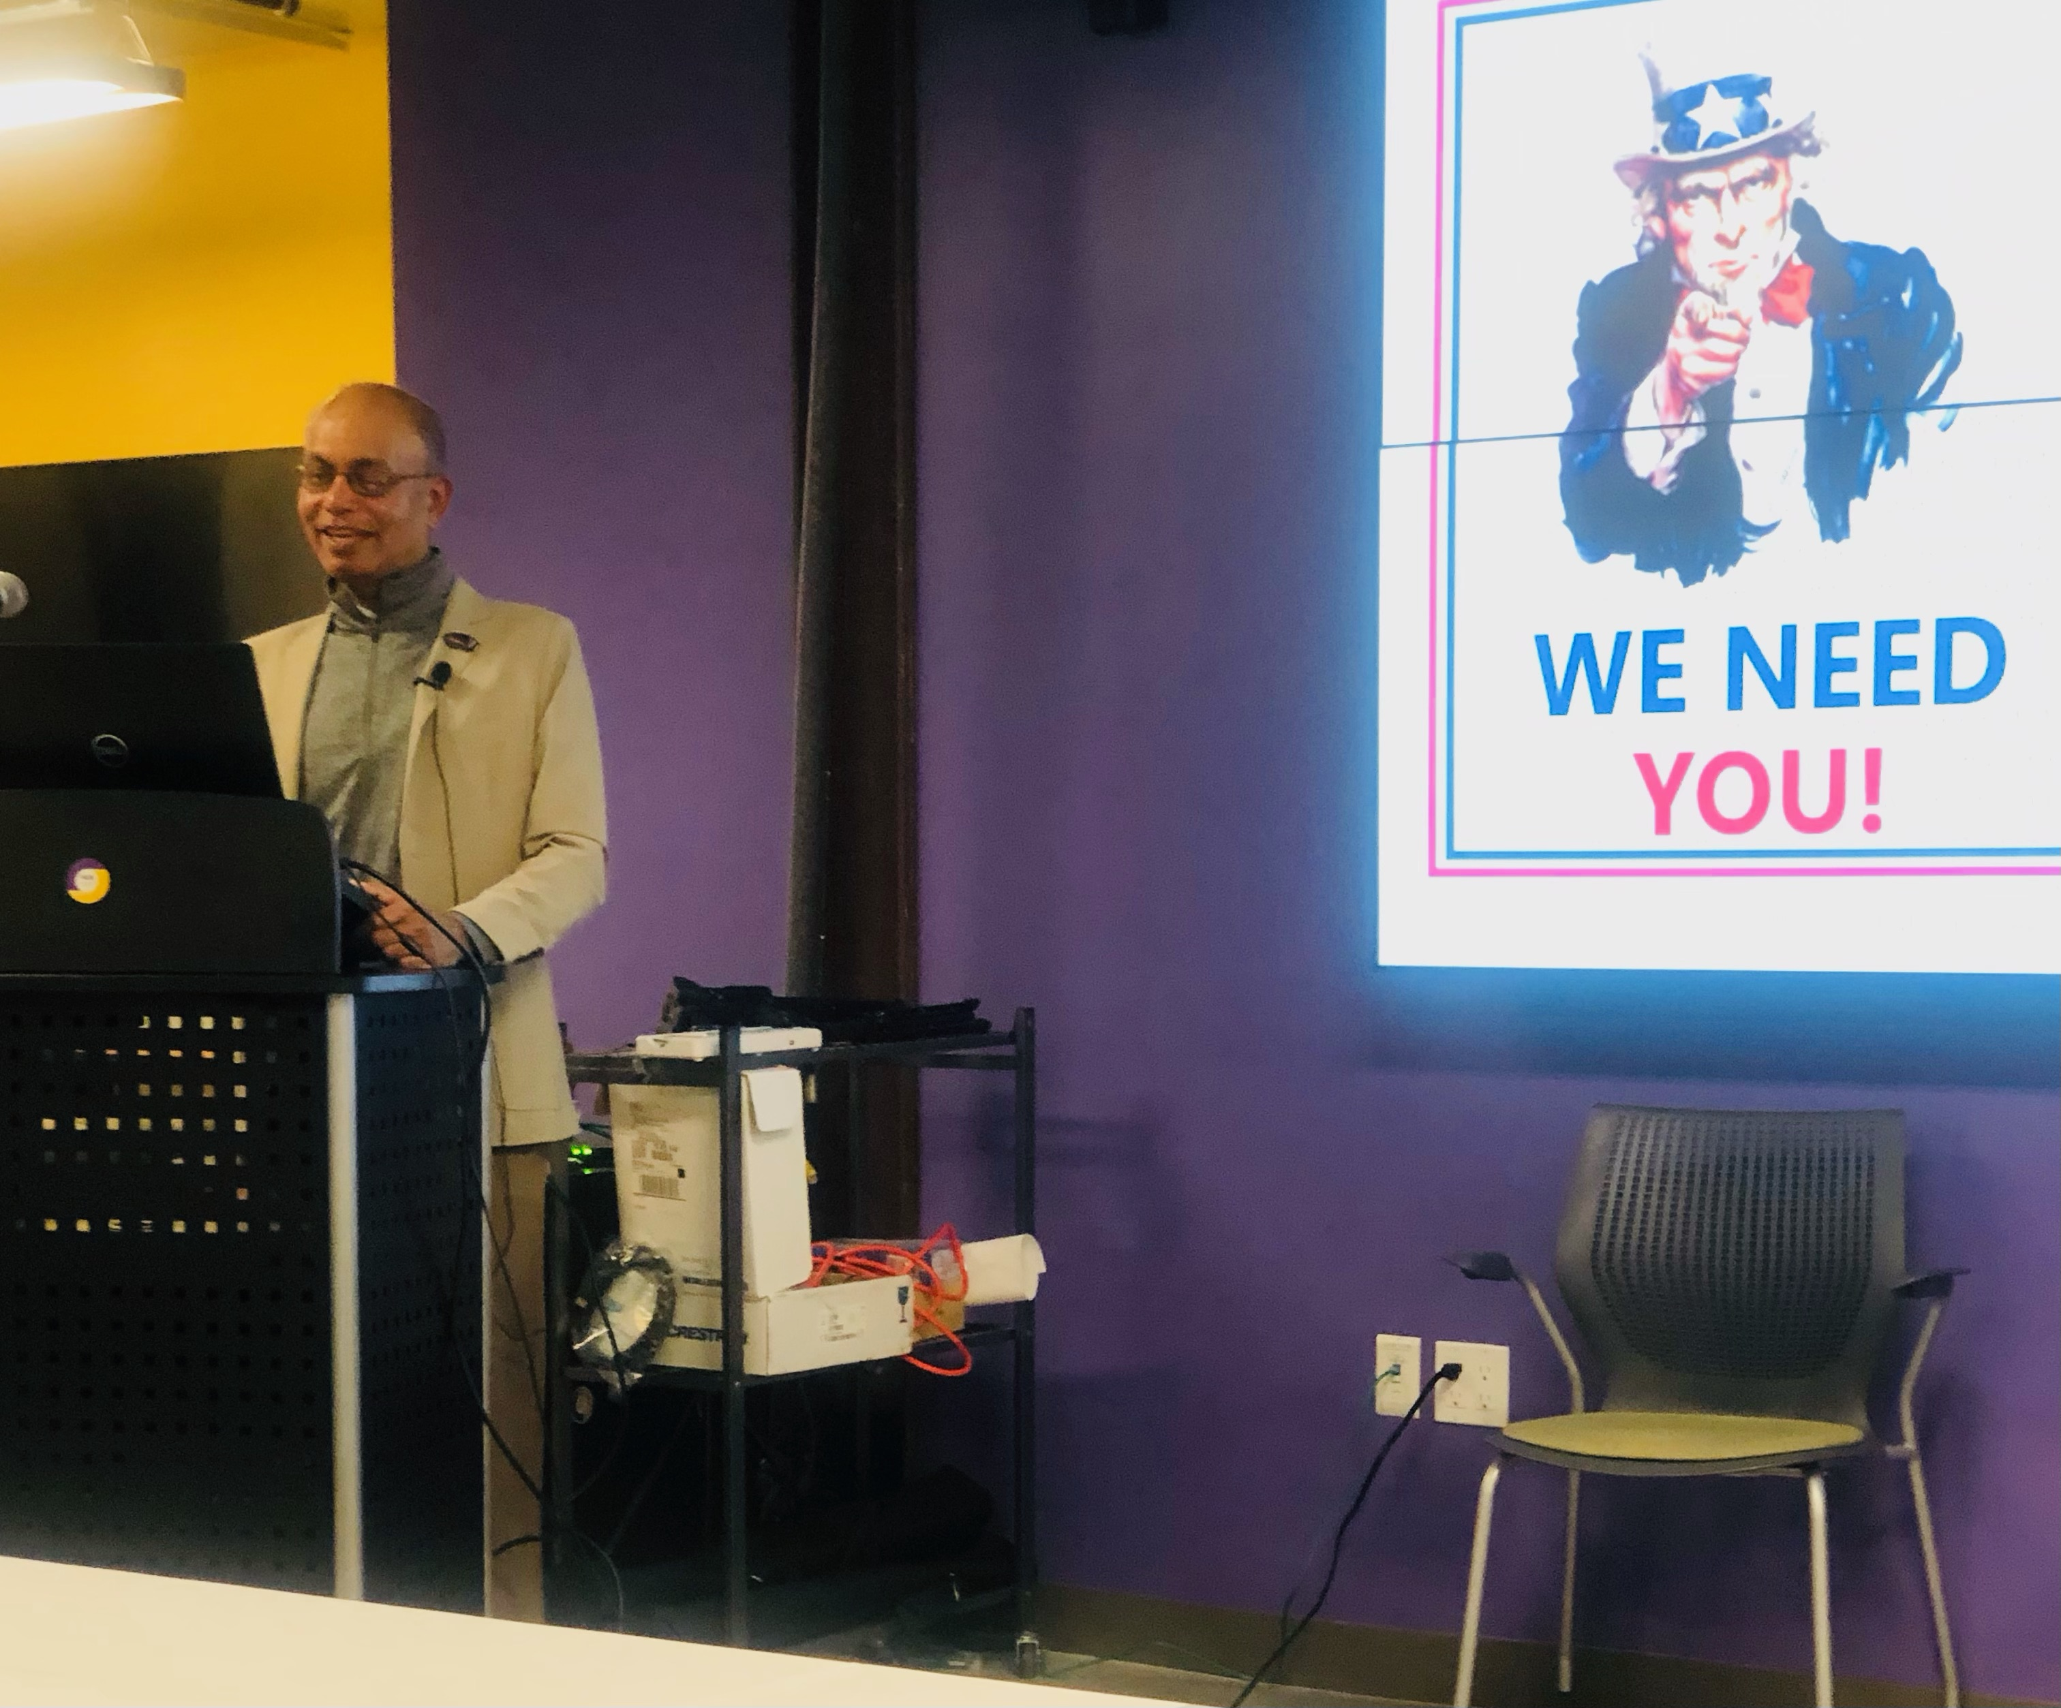
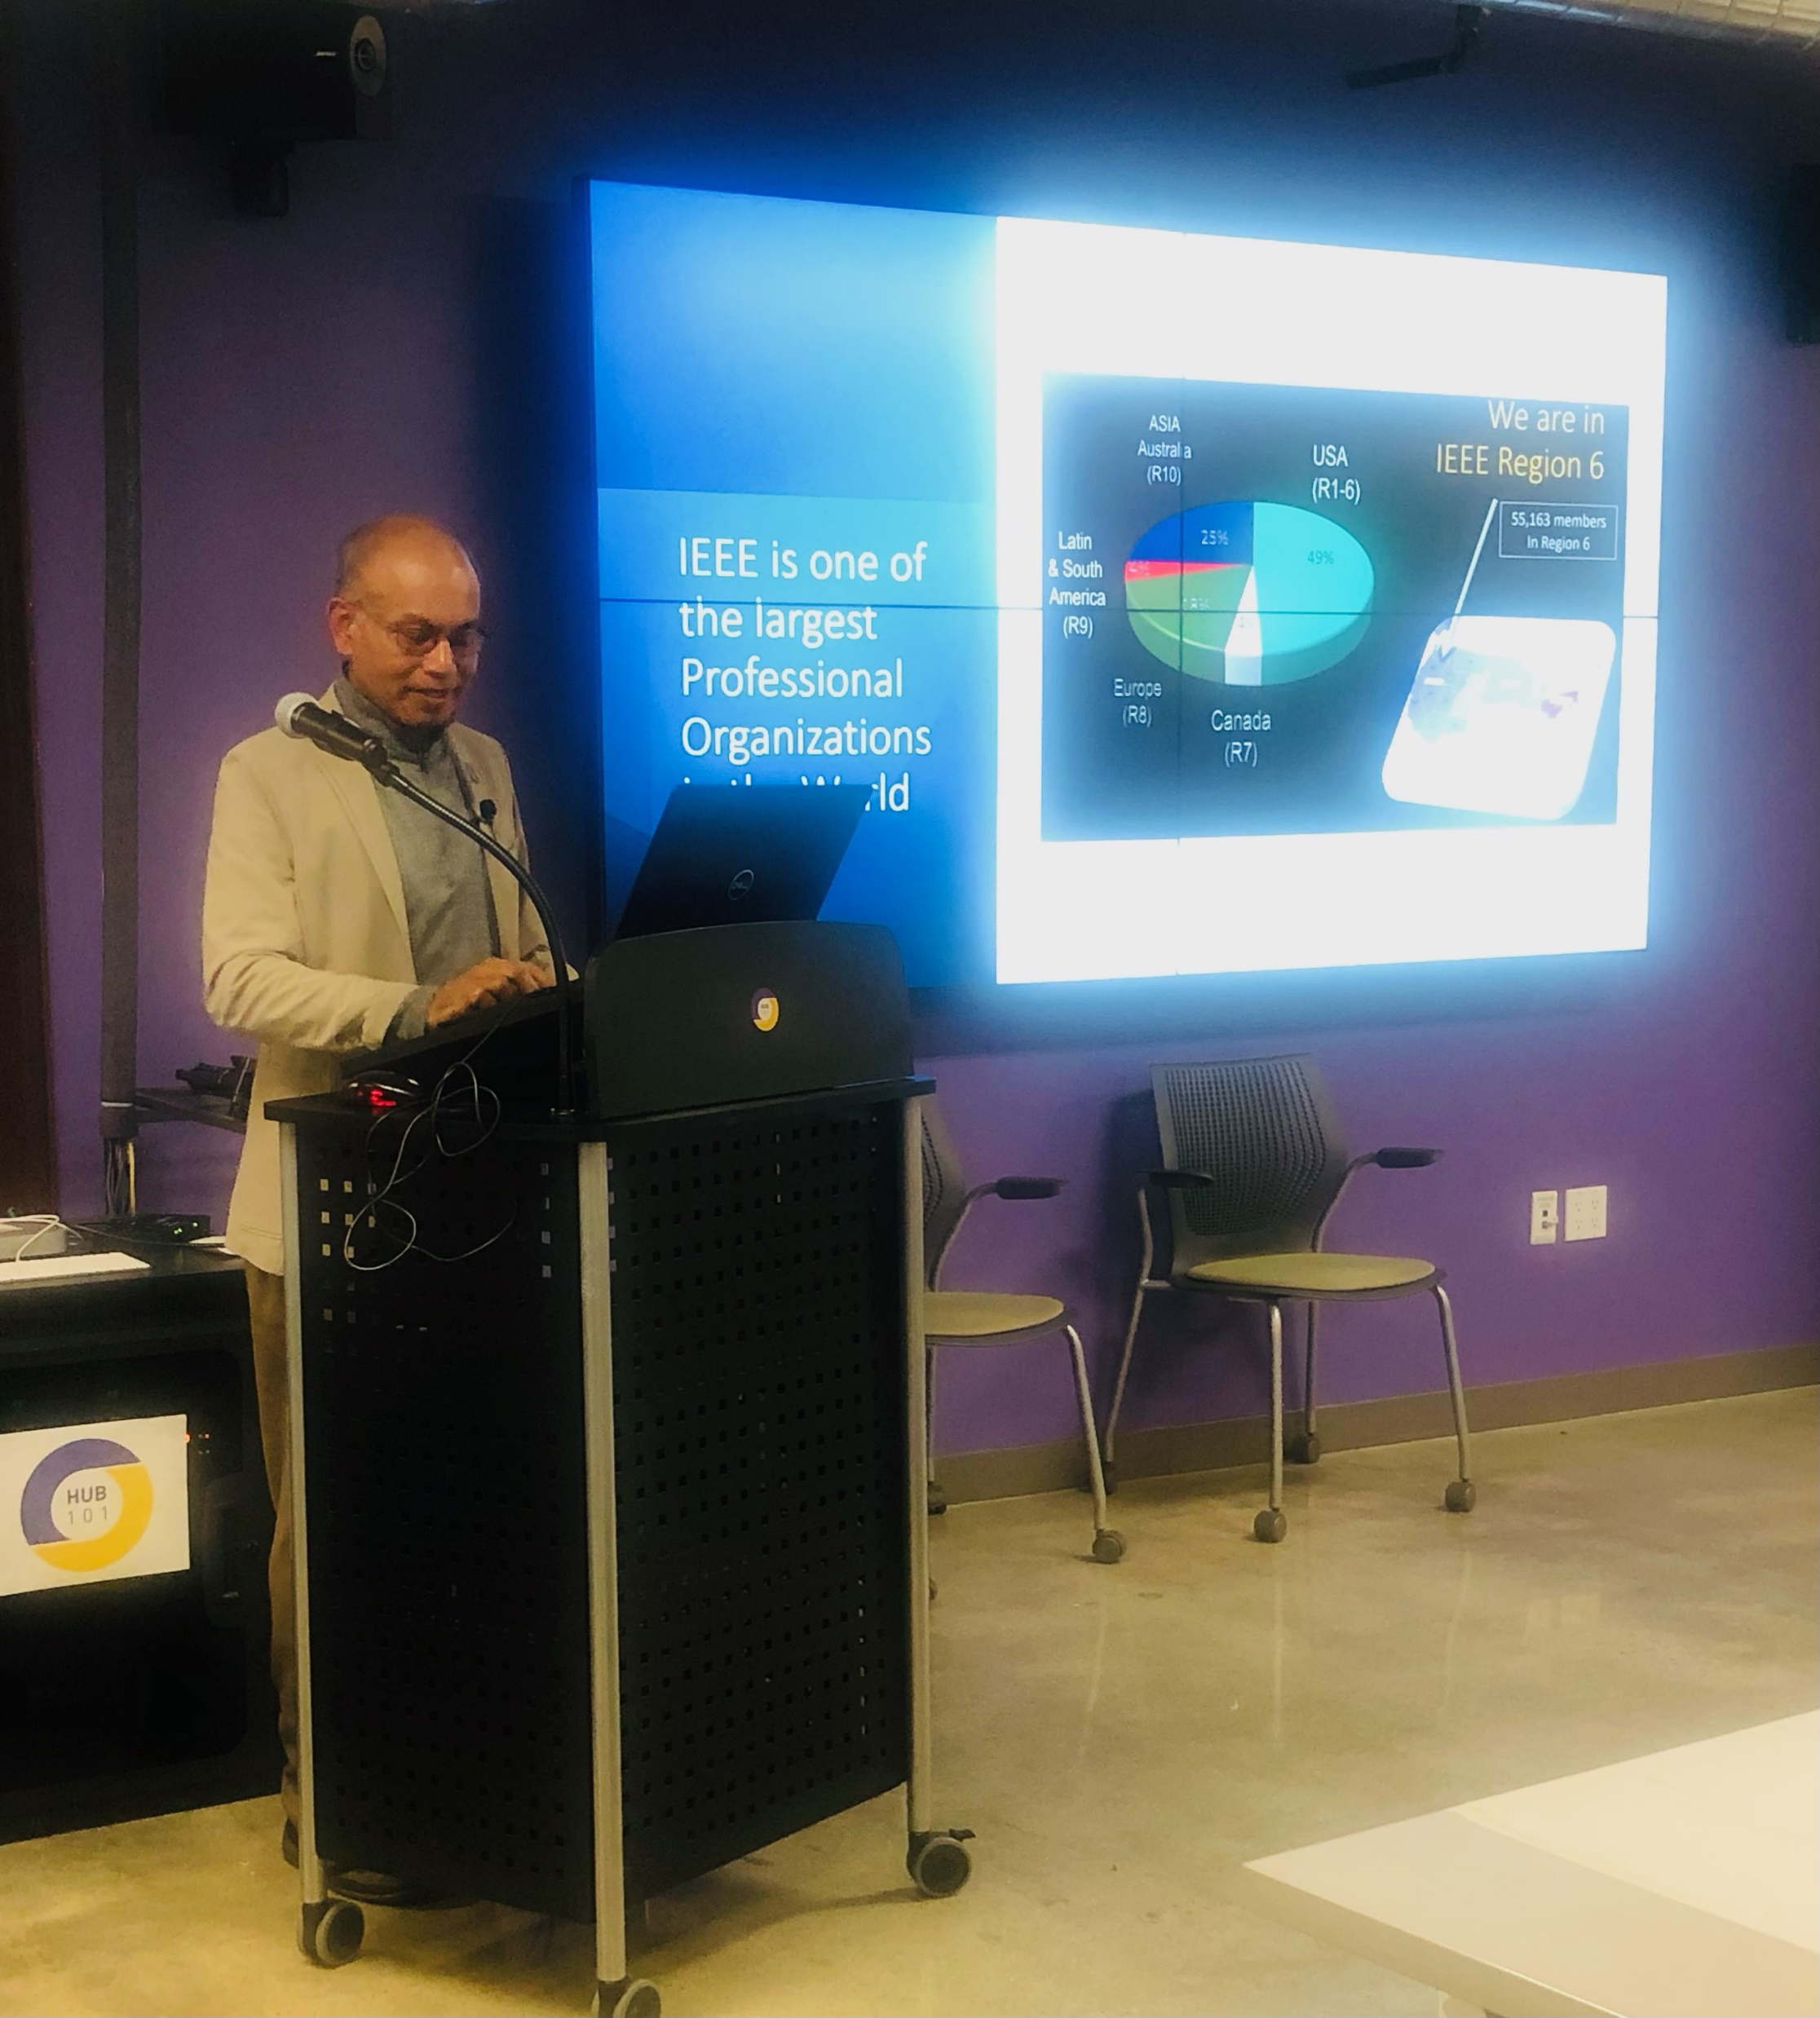

Slide 7
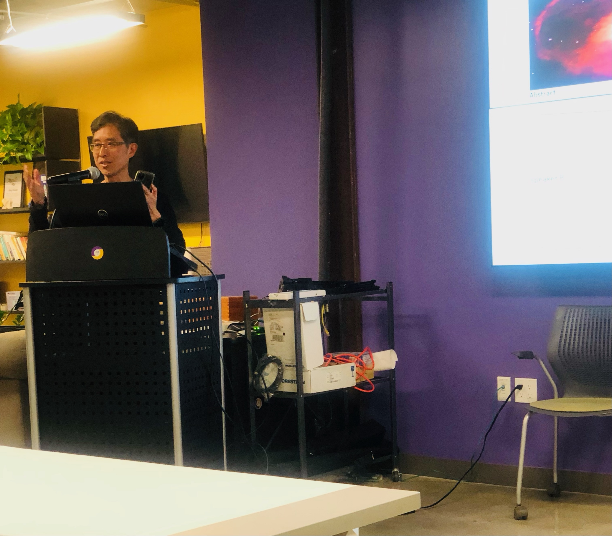

Slide 8
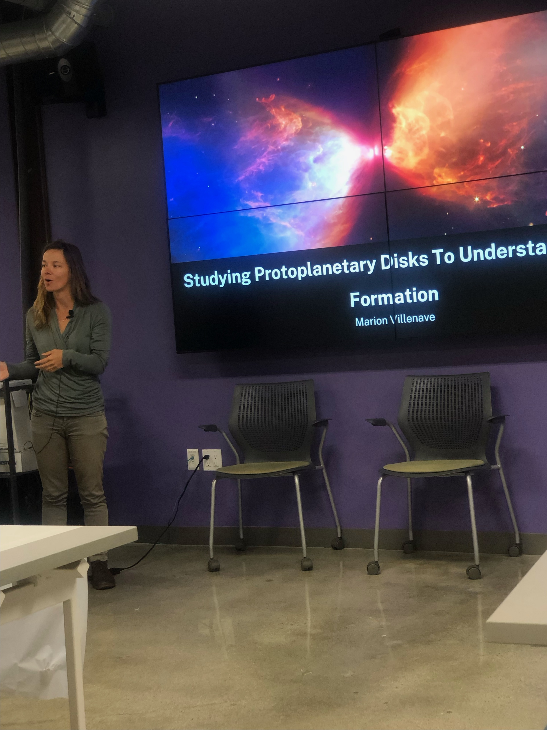

Slide 9
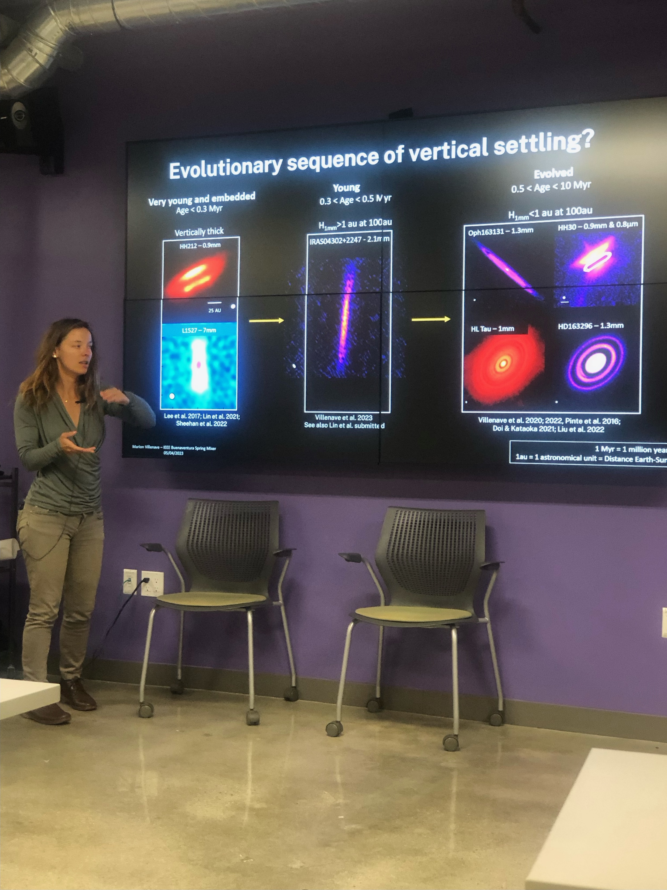

Slide 10
