Slide 1
Fall Mixer
2023

Slide 2
Second annual Fall Mixer was held at HUB101 of California Lutheran University’s extension campus, on Nov 9, 2023. The event was attended by 62 IEEE and community members. Dinner was served by Stonefire Grill courtesy of IEEE. BV Section Chair, Momin Quddus emceed the event. He presented a brief introduction to IEEE and a report on the state of IEEE National and Buenaventura Section.
IEEE BV Section awarded 3 scholarships of $1000 each to outstanding engineering students from local colleges. The recipients of the scholarships were, Tara Pai (Moorpark College) , Jaycee Alipio (Moorpark College) and Nouh Sepulveda (Oxnard College). Scholarship Committee chair, Dennis Horwitz presented the scholarship awards. In addition, the recipients were presented a gift and a free 1 year membership to IEEE by the Buenaventura Section Executive Committee.
Keynote speech was presented by Mr. Hoppy Price of Jet Propulsion Laboratories (JPL/NASA/CalTech) on Robotic Lunar Village. Mr. Price explained the technology, Plan and budgetary requirements for a future lunar village. The lecture was very well received by the audience followed by a vibrant Q & A session.
At the end of the lecture the attendees, officers and the speaker had the opportunity to socialize and mingle for 30 minutes.

Slide 3
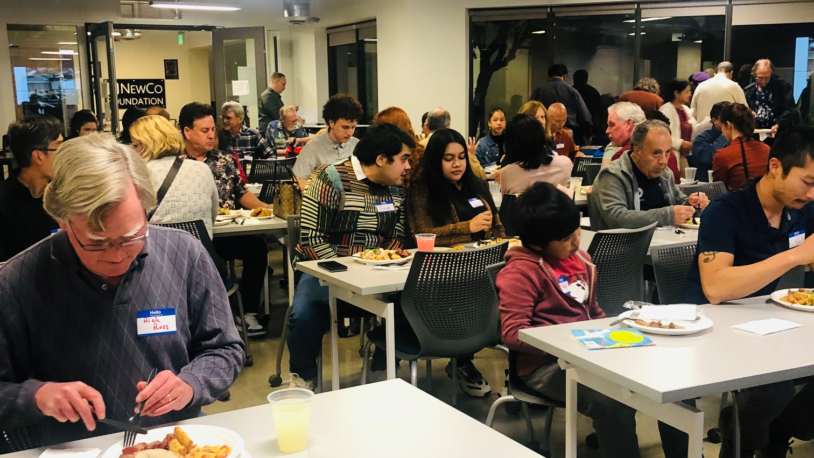

Slide 4
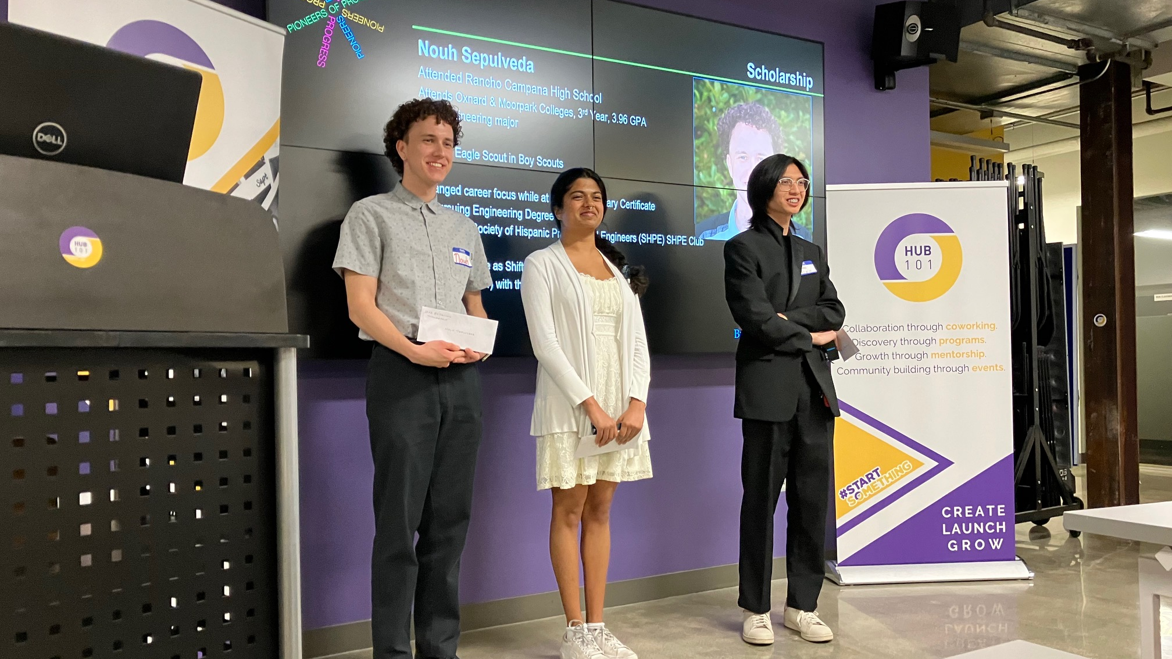

Slide 5
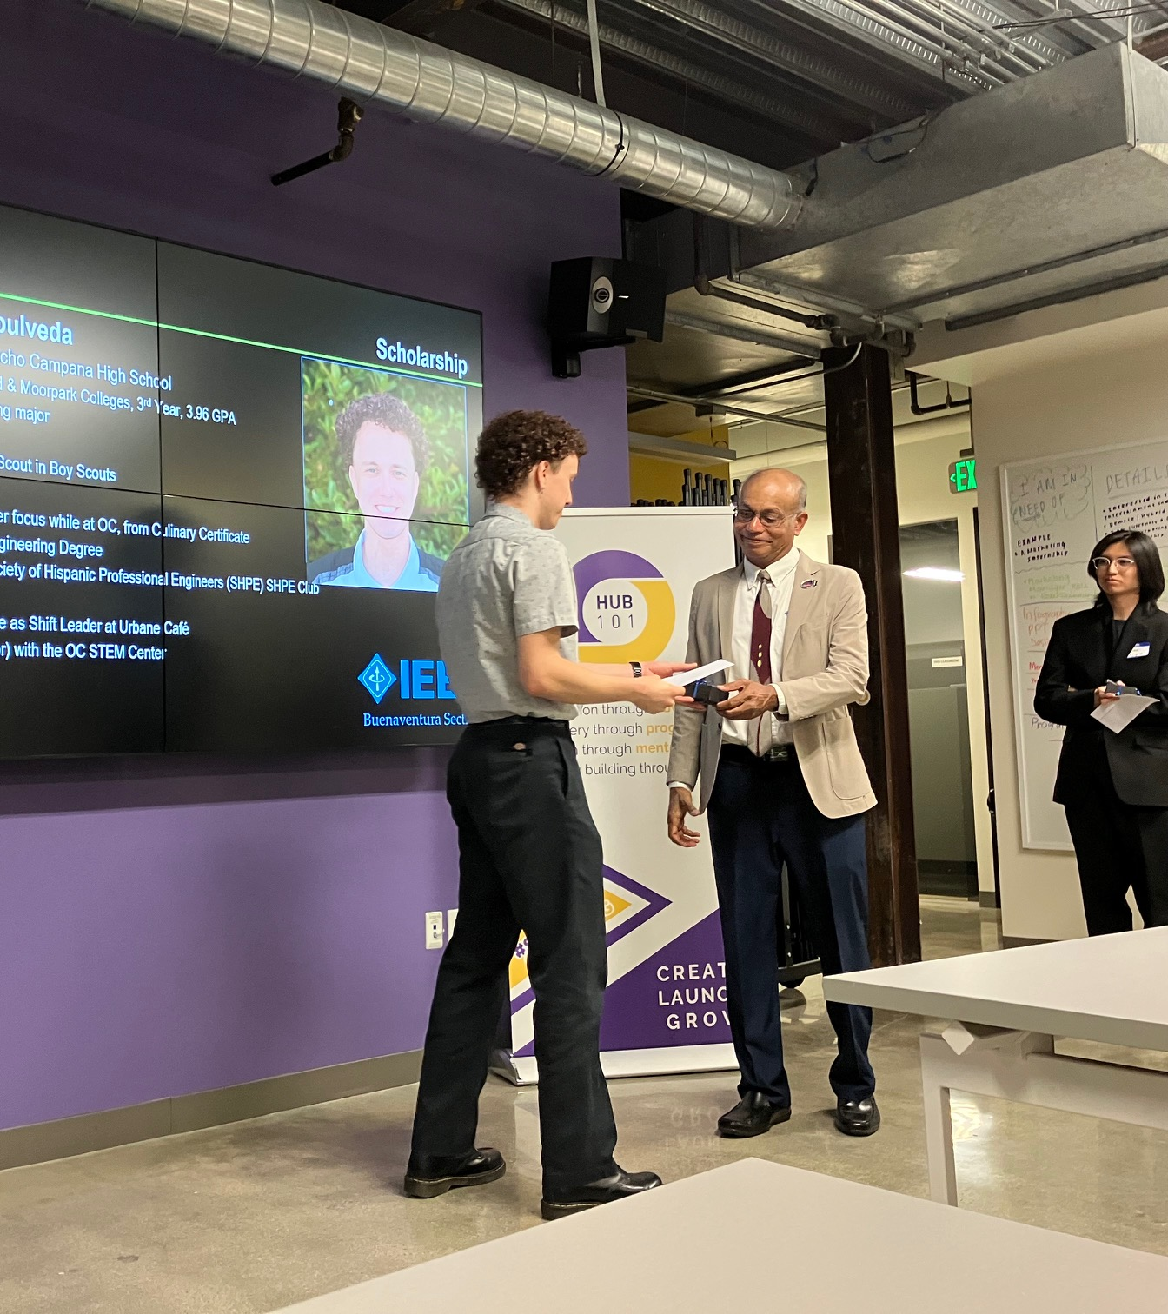
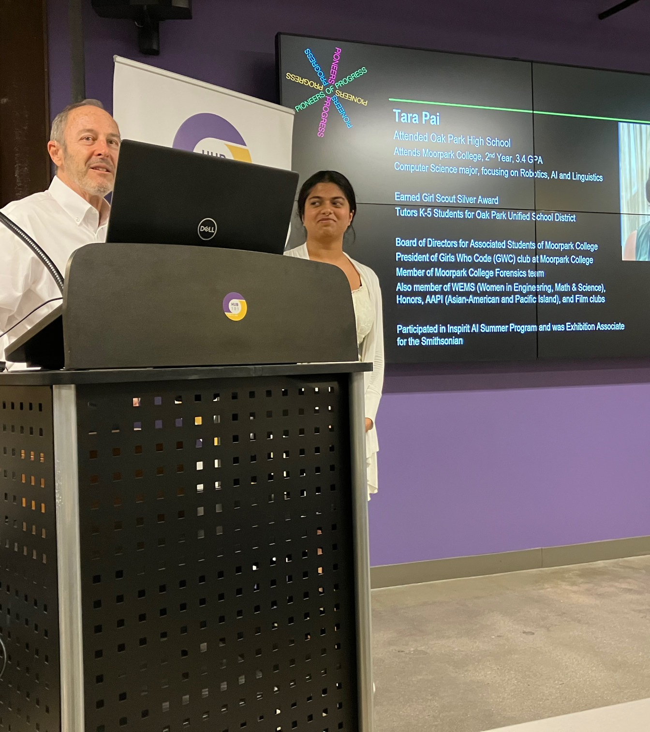

Slide 6
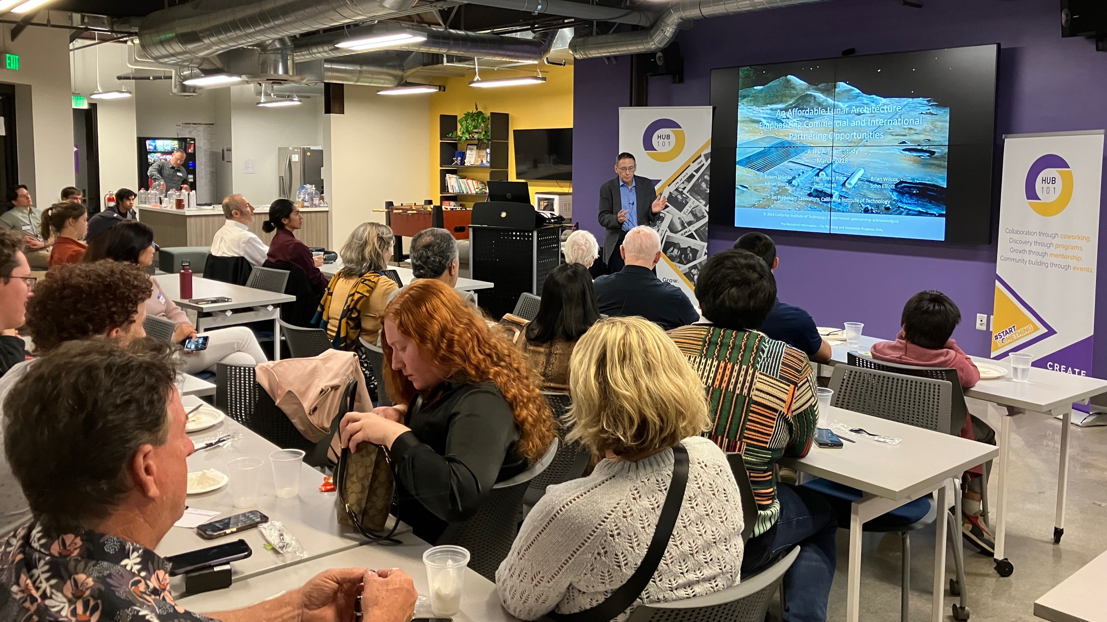

Slide 7
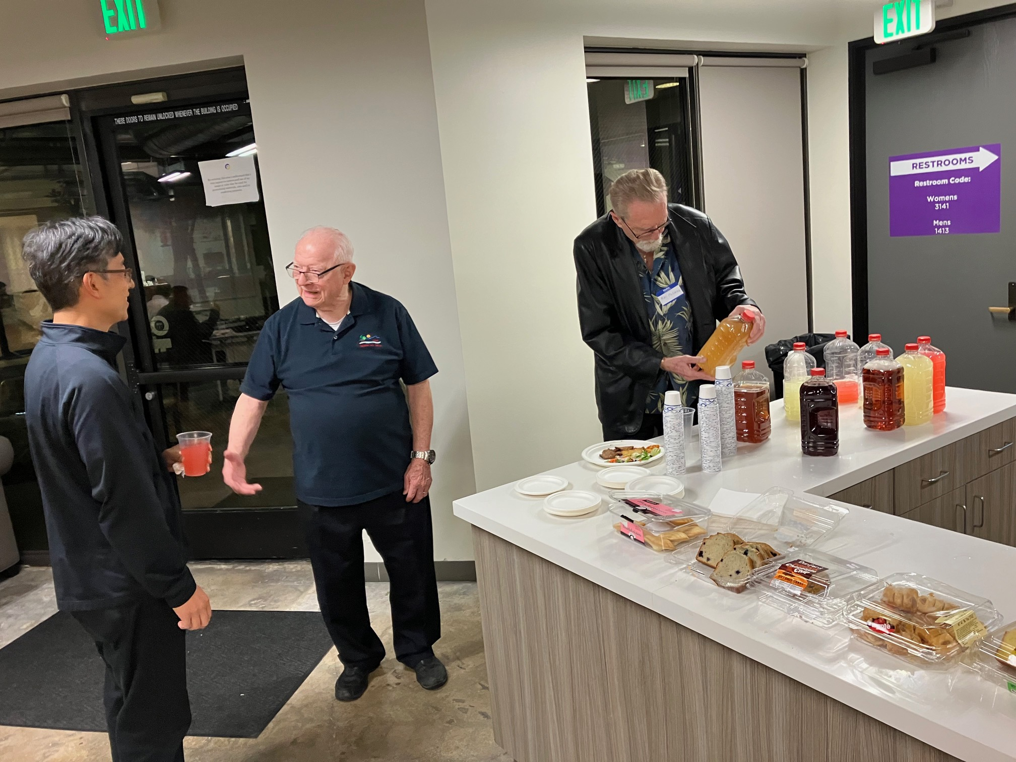
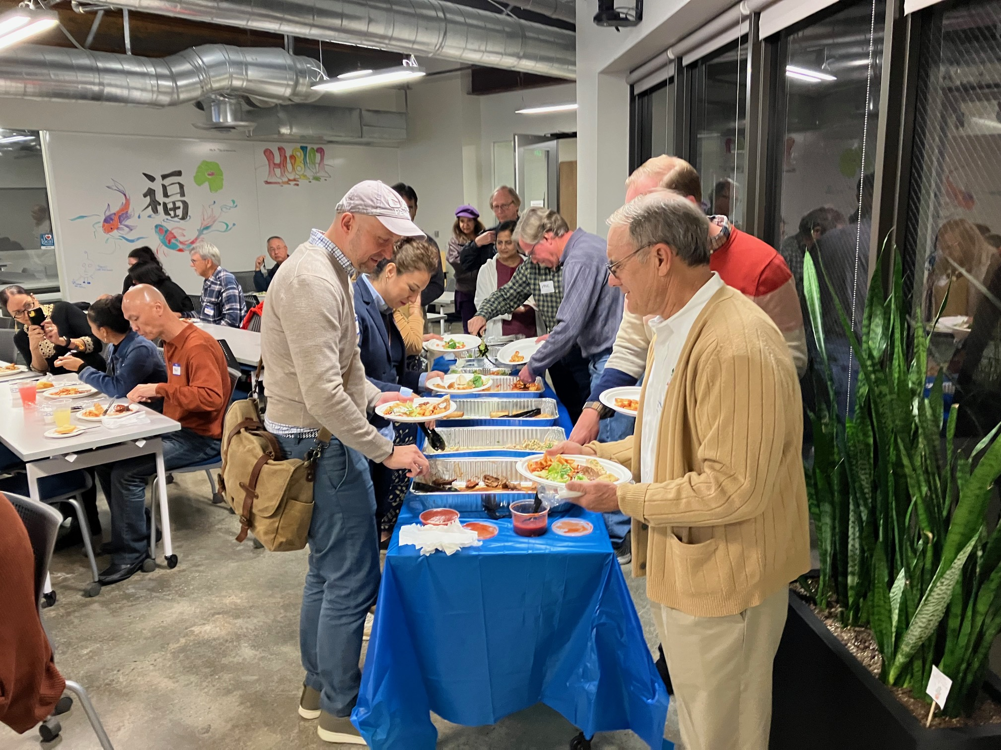

Slide 8
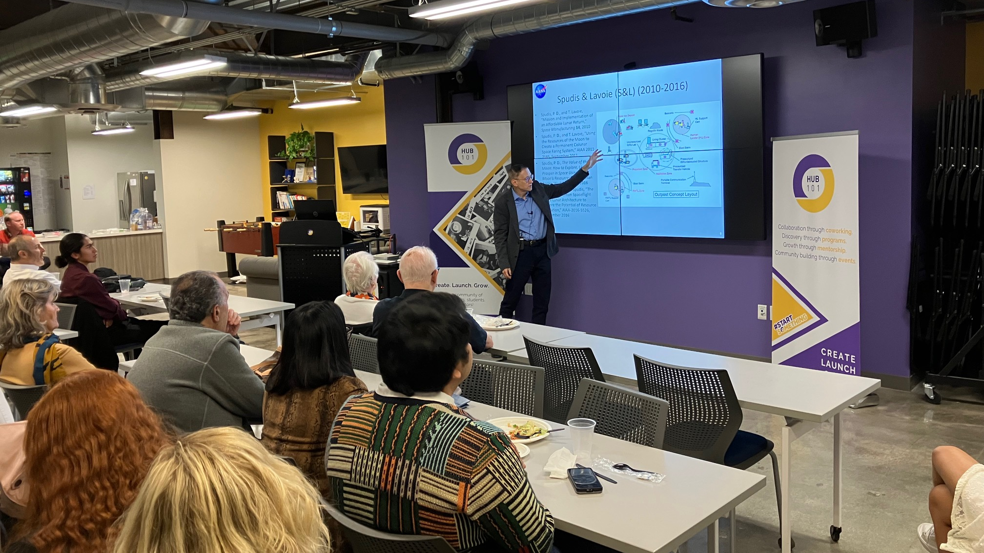

Slide 9
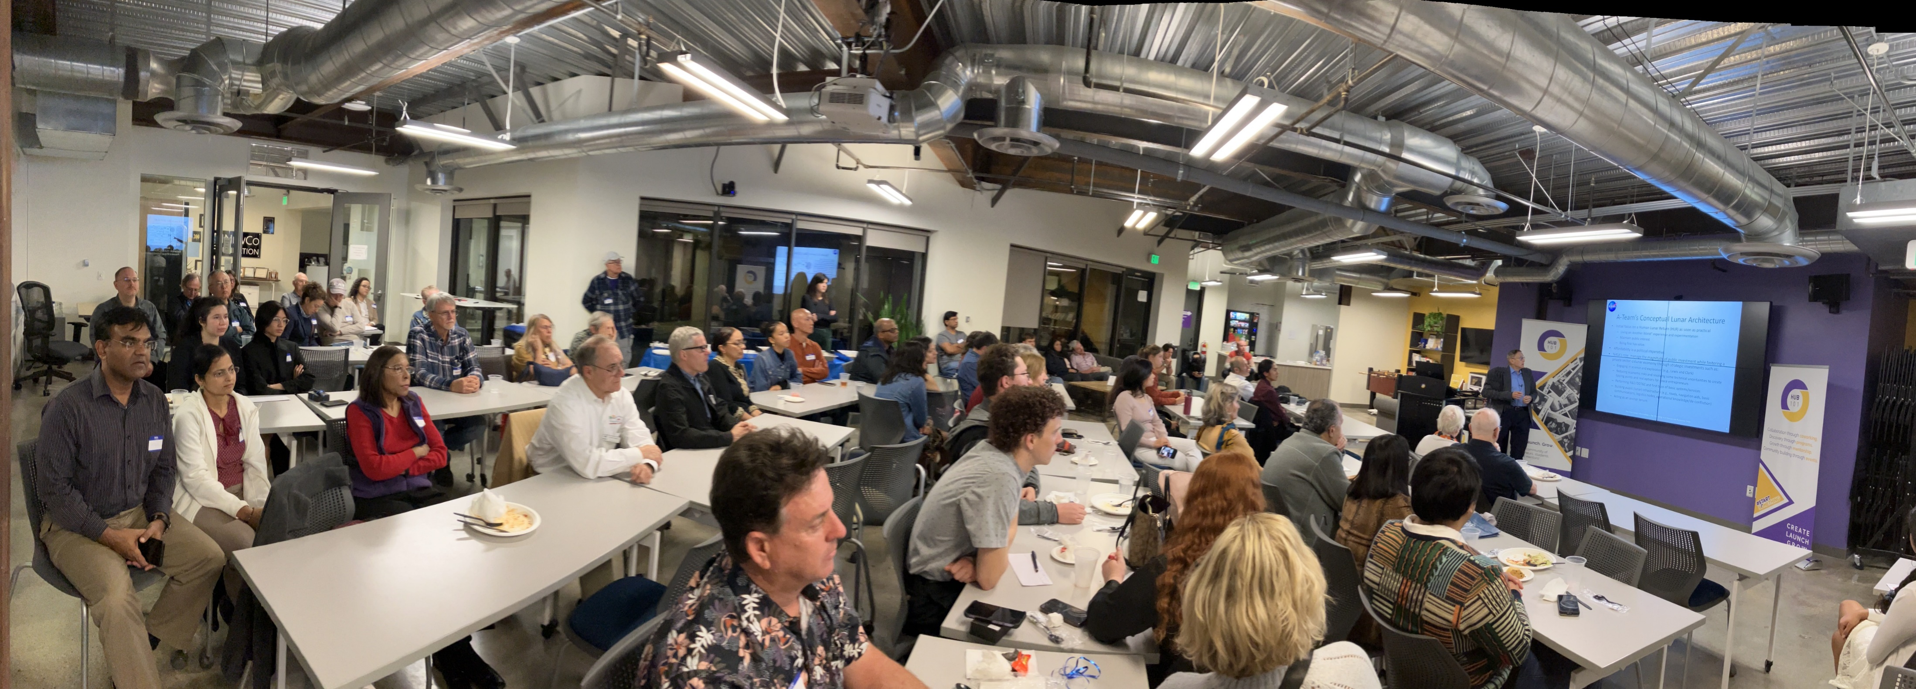

Slide 10
